Slide 1
Addition and removal energies via the IM-SRG method
Fei Yuan
Committee: Morten Hjorth-Jensen Scott Bogner Alexandra Gade Carlo Piermarocchi Scott Pratt
2018-01-24

Slide 2
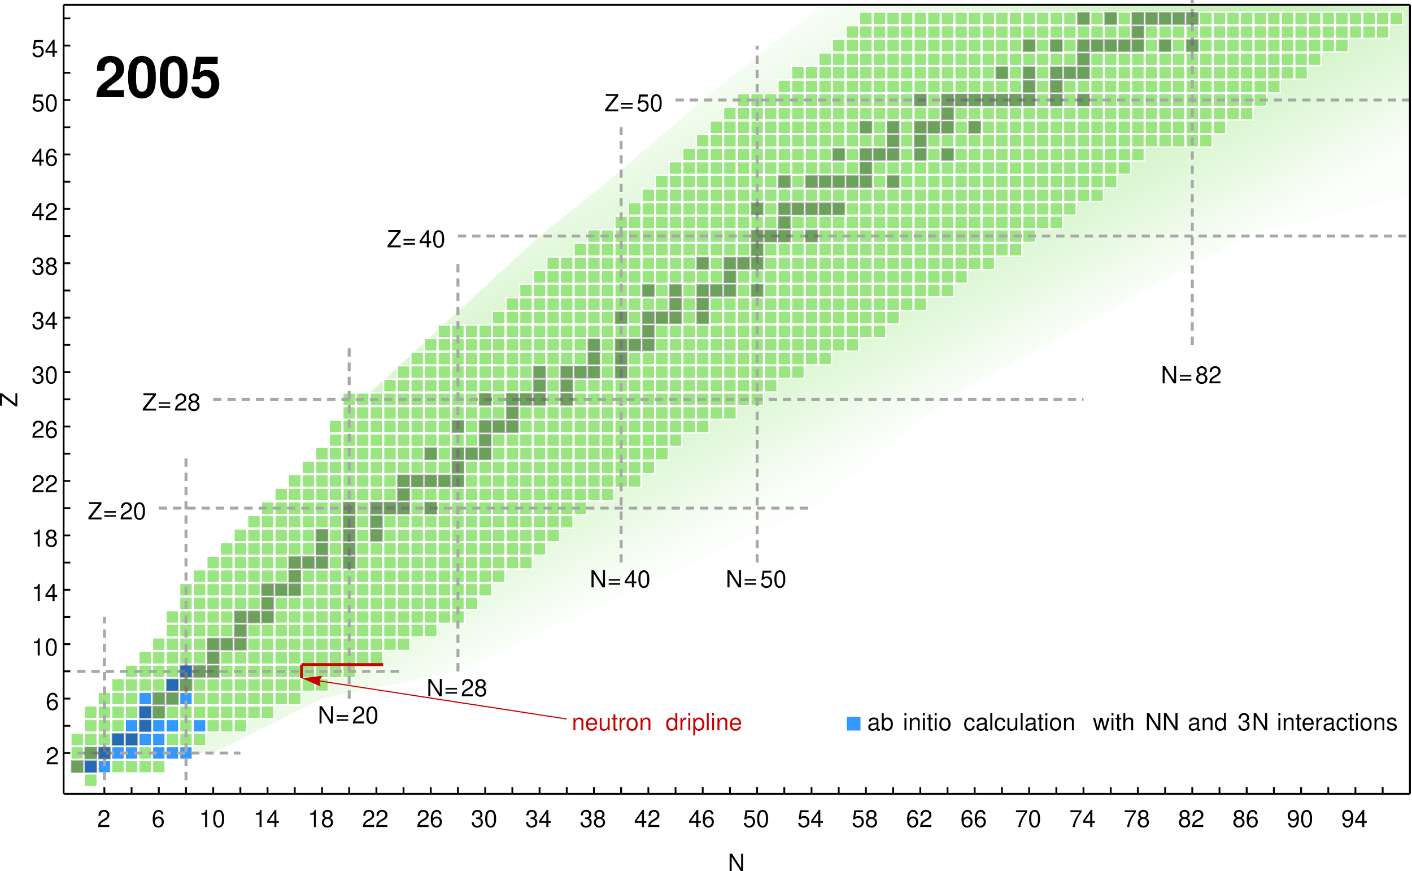
Nuclear chart of ab initio theory (2005)
(image courtesy of Heiko Hergert)
Notes:
In ab initio many-body theory, we start from

Slide 3
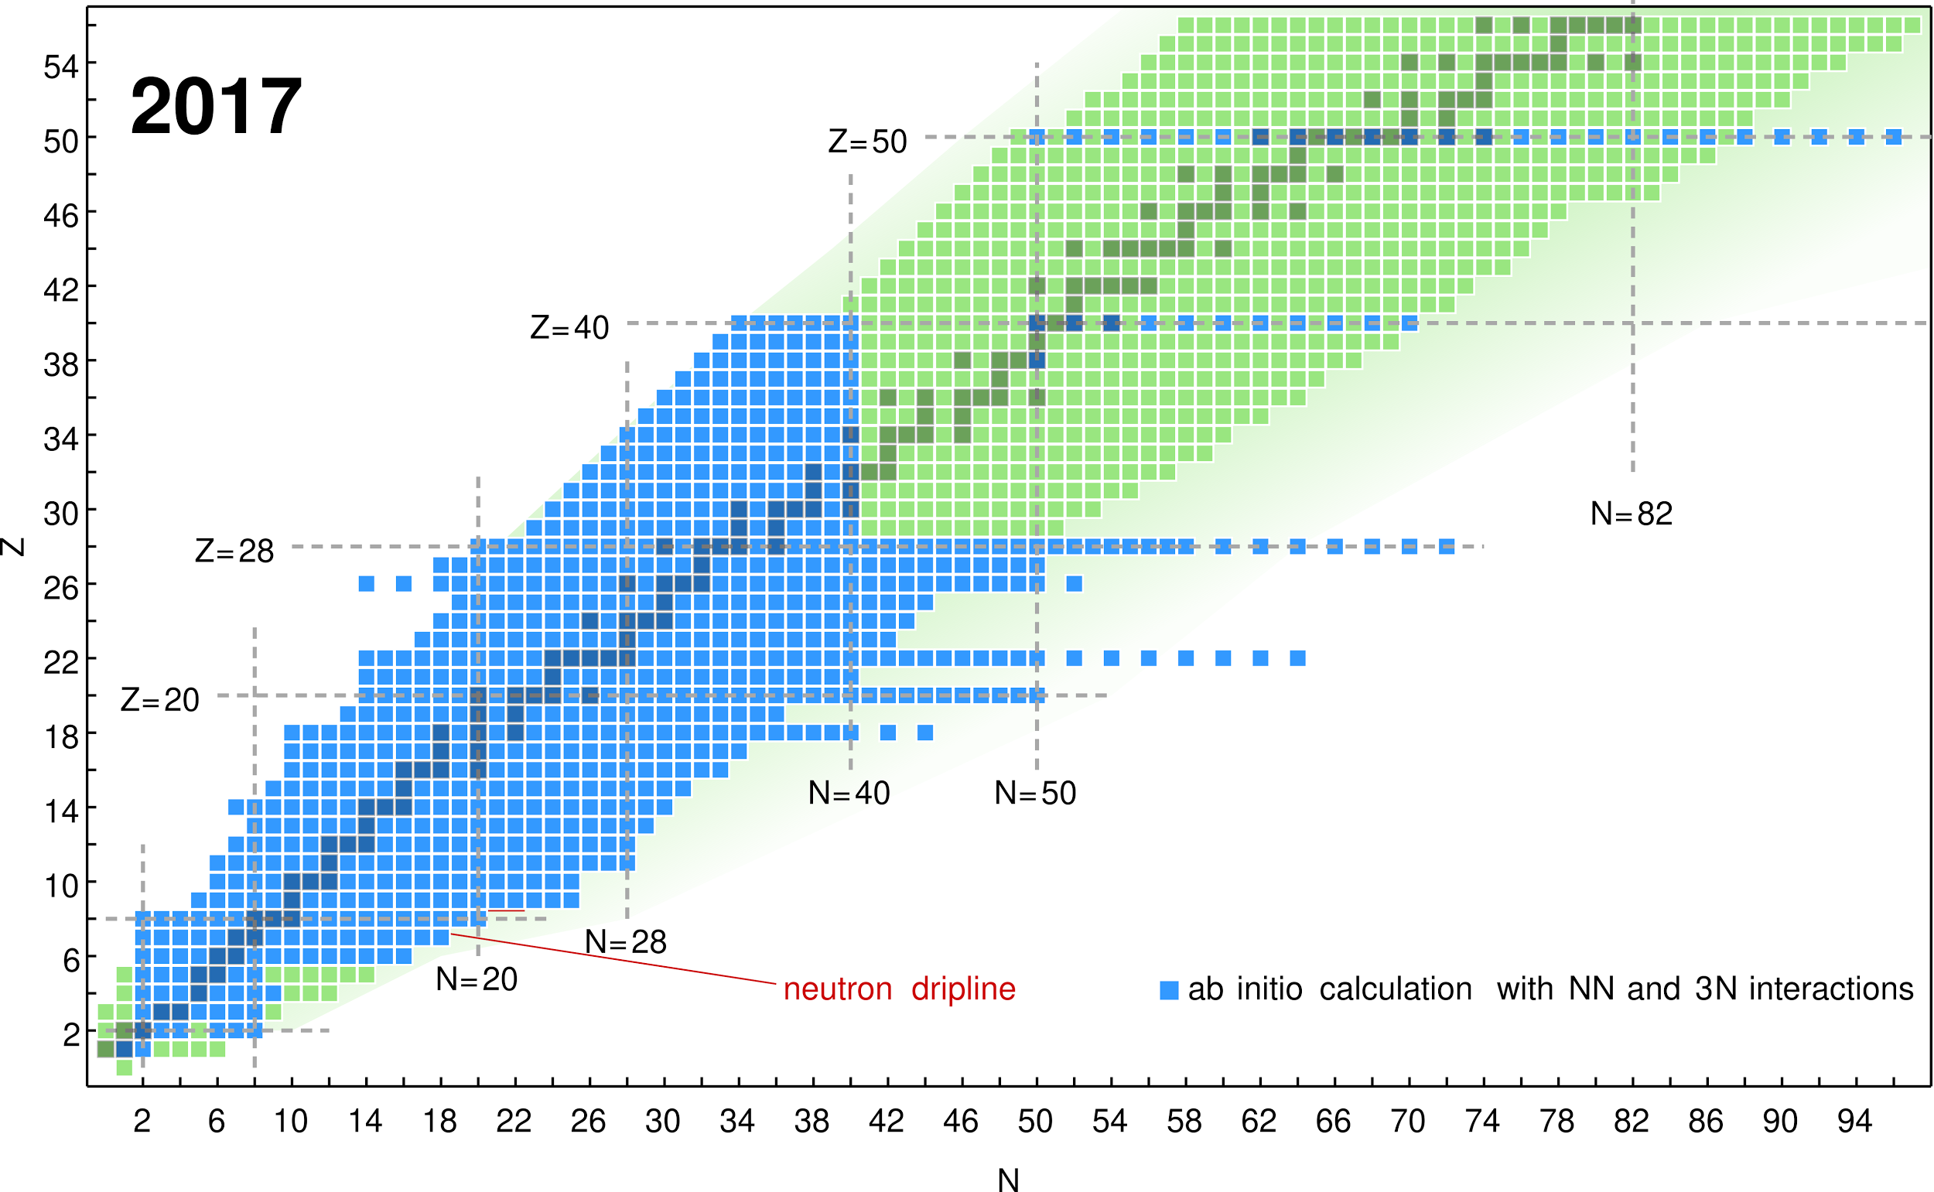
Nuclear chart of ab initio theory (2017)
(image courtesy of Heiko Hergert)

Slide 4
Nuclear chart of ab initio theory (2017)
through a combination of various many-body methods
only even-even nuclei
(image courtesy of Heiko Hergert)

Slide 5
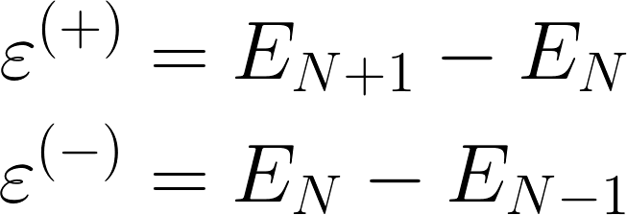
Addition and removal energies
N − 1
remove
N
add
N + 1
open shell
closed-shell
open-shell
Closed-shell systems are easy to calculate
Goal: Access open-shell systems one particle away from a closed-shell system (might even be an excited state!)
addition energy:
removal energy:

Slide 6
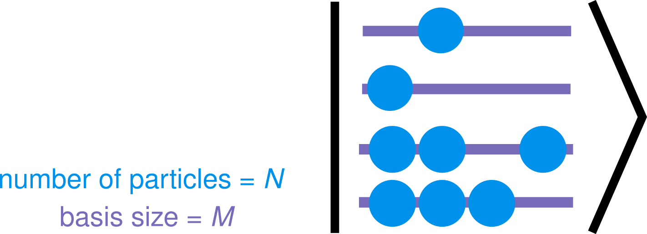

Fundamental challenge of many-body physics
There are a lot of states in a many-body system.
E.g. N-particle state in a single-particle basis of size M
Combinatorial growth ⇒ Rapid growth of memory and CPU time needed
Fortunately, not all states are equally important

Slide 7
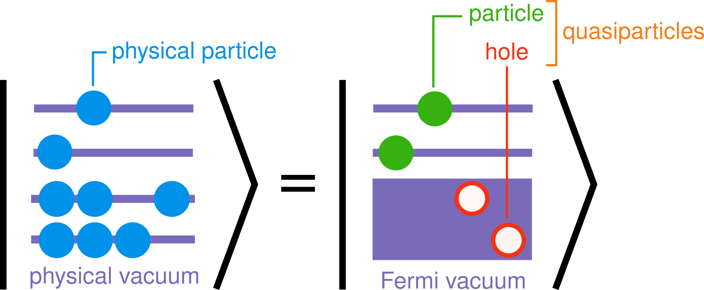
Encoding states using a single reference
Can we encode states more efficiently in many-body theory?
Start with an approximation of target state → called a reference state
Use the reference state as our “background” → (Fermi vacuum)

Slide 8
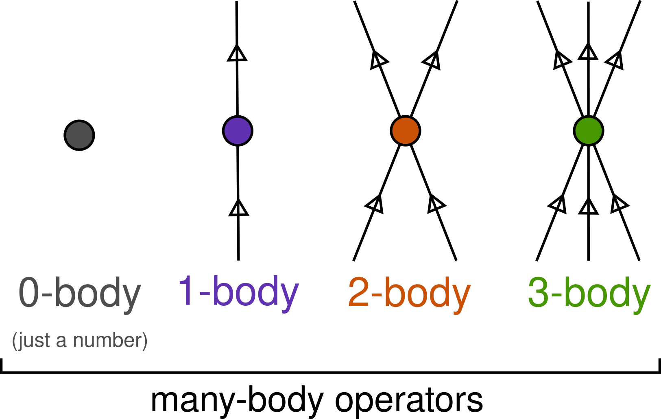

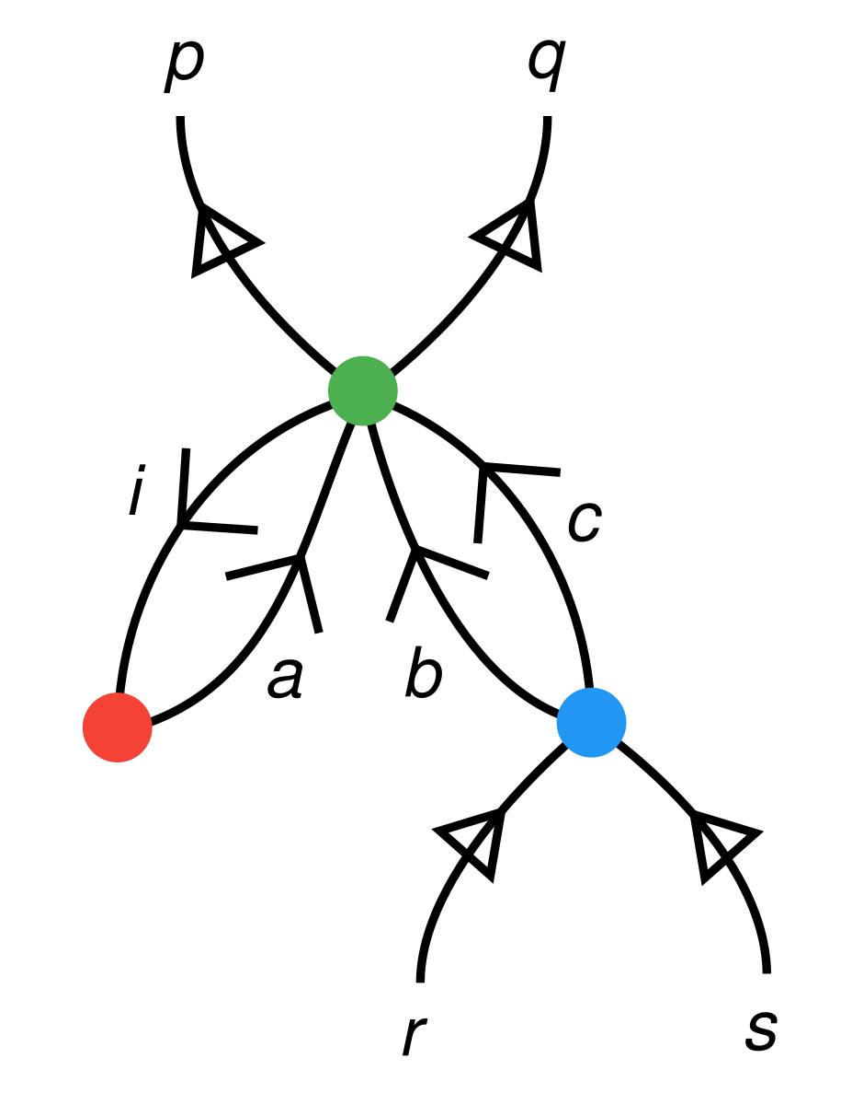
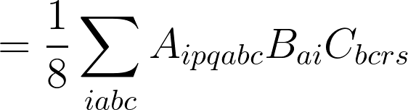
Many-body operators and diagrams
Similar to Feynman diagrams:
Has both formal algebraic and intuitive physical interpretations
Node = matrix/operator
Line = single-particle state
= particle
= hole
Example: formal interpretation of a many-body diagram
A
C
B
Notes:
= \frac{1}{8} \sum_{i a b c} A_{i p q a b c} B_{a i} C_{b c r s}

Slide 9
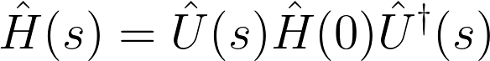
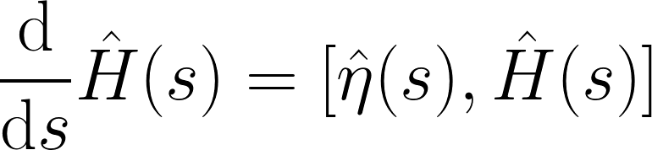
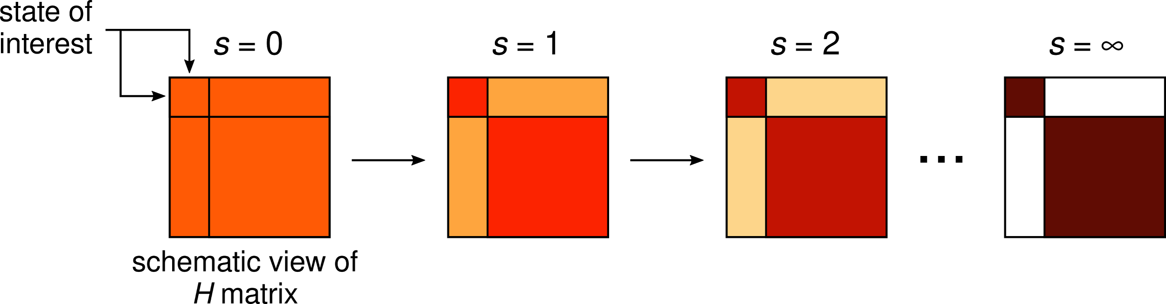
Similarity renormalization group (SRG)
SRG: Continuous unitary transformation (evolution) of Hamiltonian
Defined by the differential equation (flow equation)
η = generator of the transformation that we get to choose!
unitary: U U † = 1
flow parameter
energy of the state
evolved Hamiltonian can be used as input for other methods

Slide 10
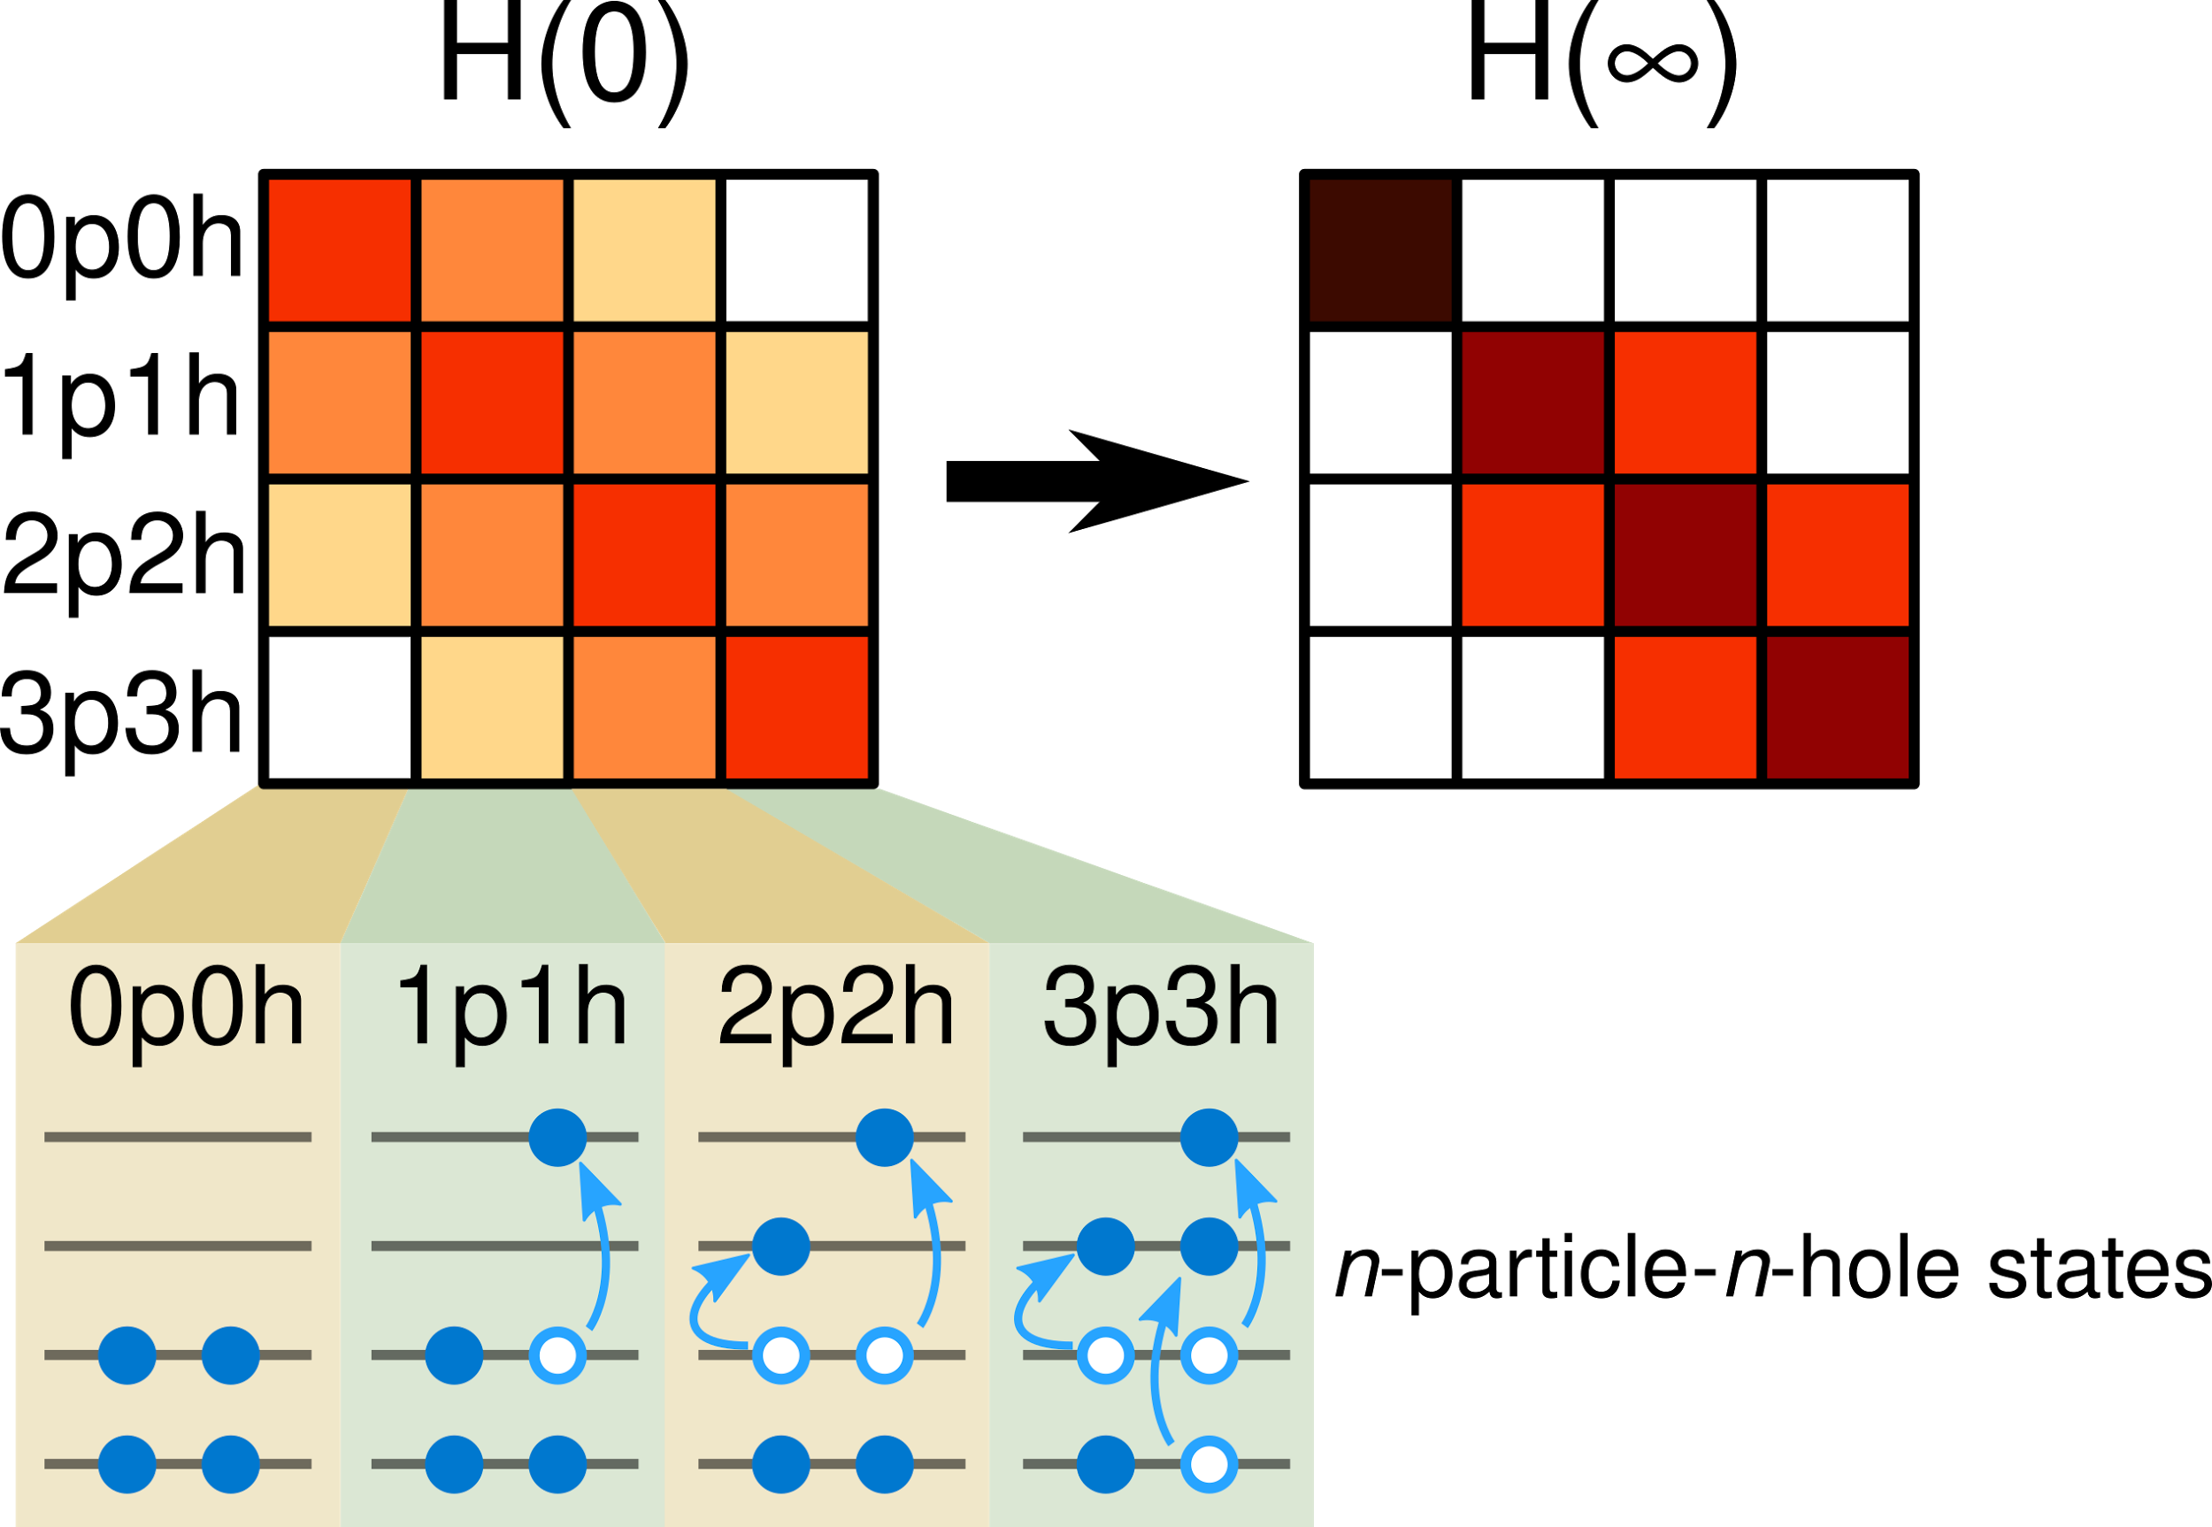
In-medium SRG (IM-SRG)
IM-SRG: SRG using the many-body framework [Hergert et al 2016]
reference state =

Slide 11
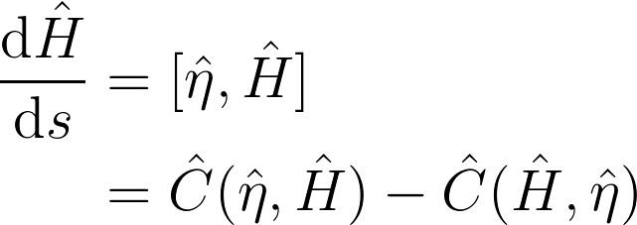
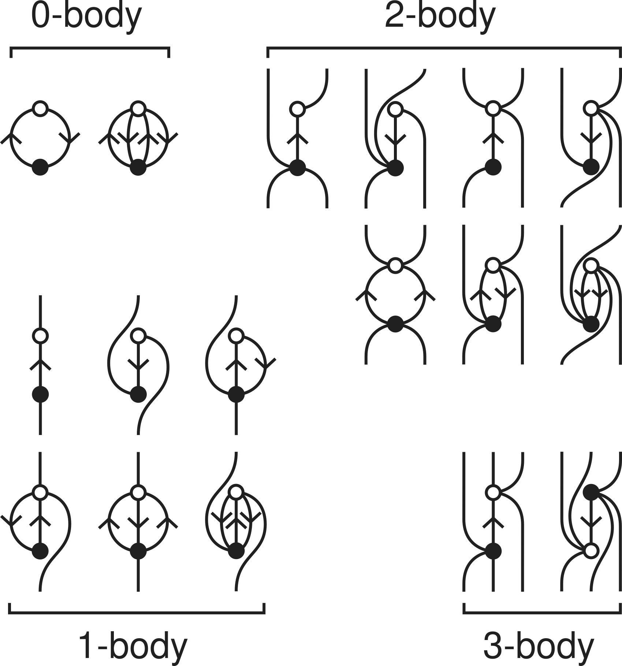
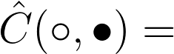
IM-SRG commutator
where
Bulk of the IM-SRG calculation
(most computationally expensive part)
truncated in
IM-SRG(2)
Notes:
\begin{align*}
\frac{\mathrm d \hat{H}}{\mathrm d s}
&= [\hat{\eta}, \hat{H}] \\
&= \hat{C}(\hat{\eta}, \hat{H}) - \hat{C}(\hat{H}, \hat{\eta})
\end{align*}

Slide 12
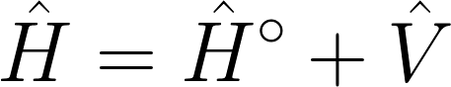
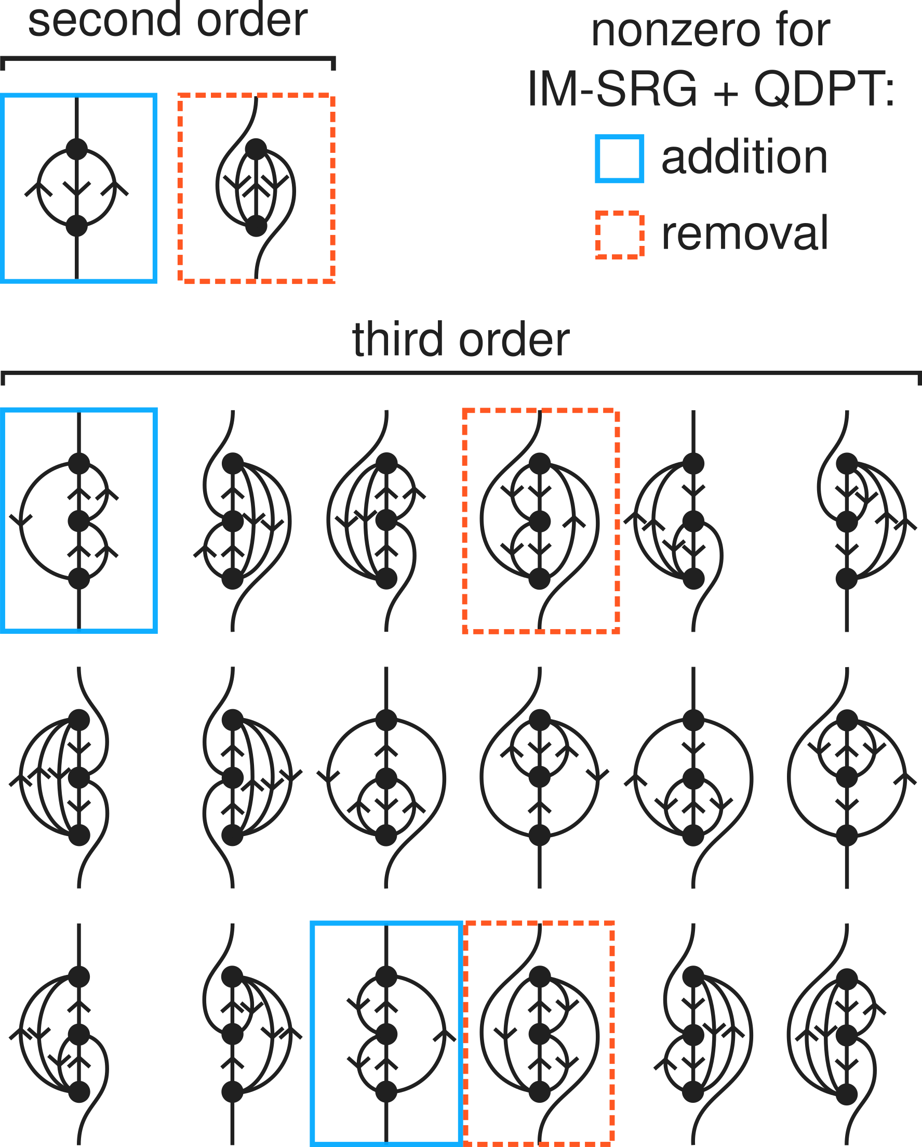
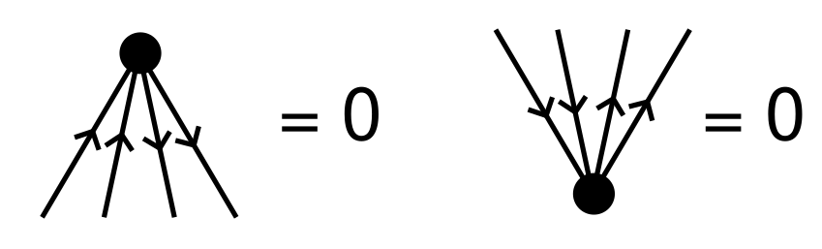
Quasidegenerate perturbation theory (QDPT)
QDPT: Perturbation theory (PT) for open-shell systems, a.k.a. open-shell PT
Expand state in orders of V
Refines addition and removal energies
Diagrams up to 3rd order (QDPT3) with implicit denominators
20 diagrams → IM-SRG eliminates all but 6 of them because

Slide 13
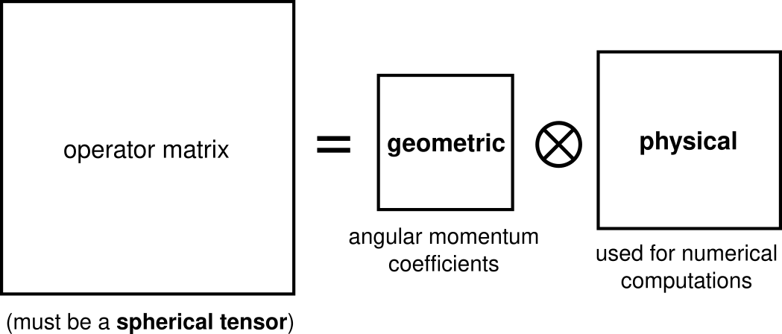
J-scheme
Exploit spherical symmetry of nuclei for efficiency
Achieved through J-scheme (antonym: M-scheme)
Angular momentum coupling increases matrix sparsity
Wigner–Eckart theorem:
Products of geometric parts (angular momentum expressions) can be simplified!

Slide 14
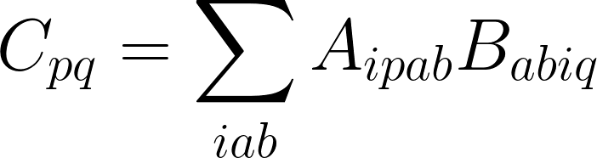
Example of a derivation in J-scheme
Derivation of equations begin in M-scheme, which is much easier to work with
Example: Convert this M-scheme equation into J-scheme:
Technical detail: For extra fun, we will assume A, B, and C to be spherical tensor operators instead of scalars. This is not used in our code, but appears in [Parzuchowski (2017) PhD thesis]

Slide 15
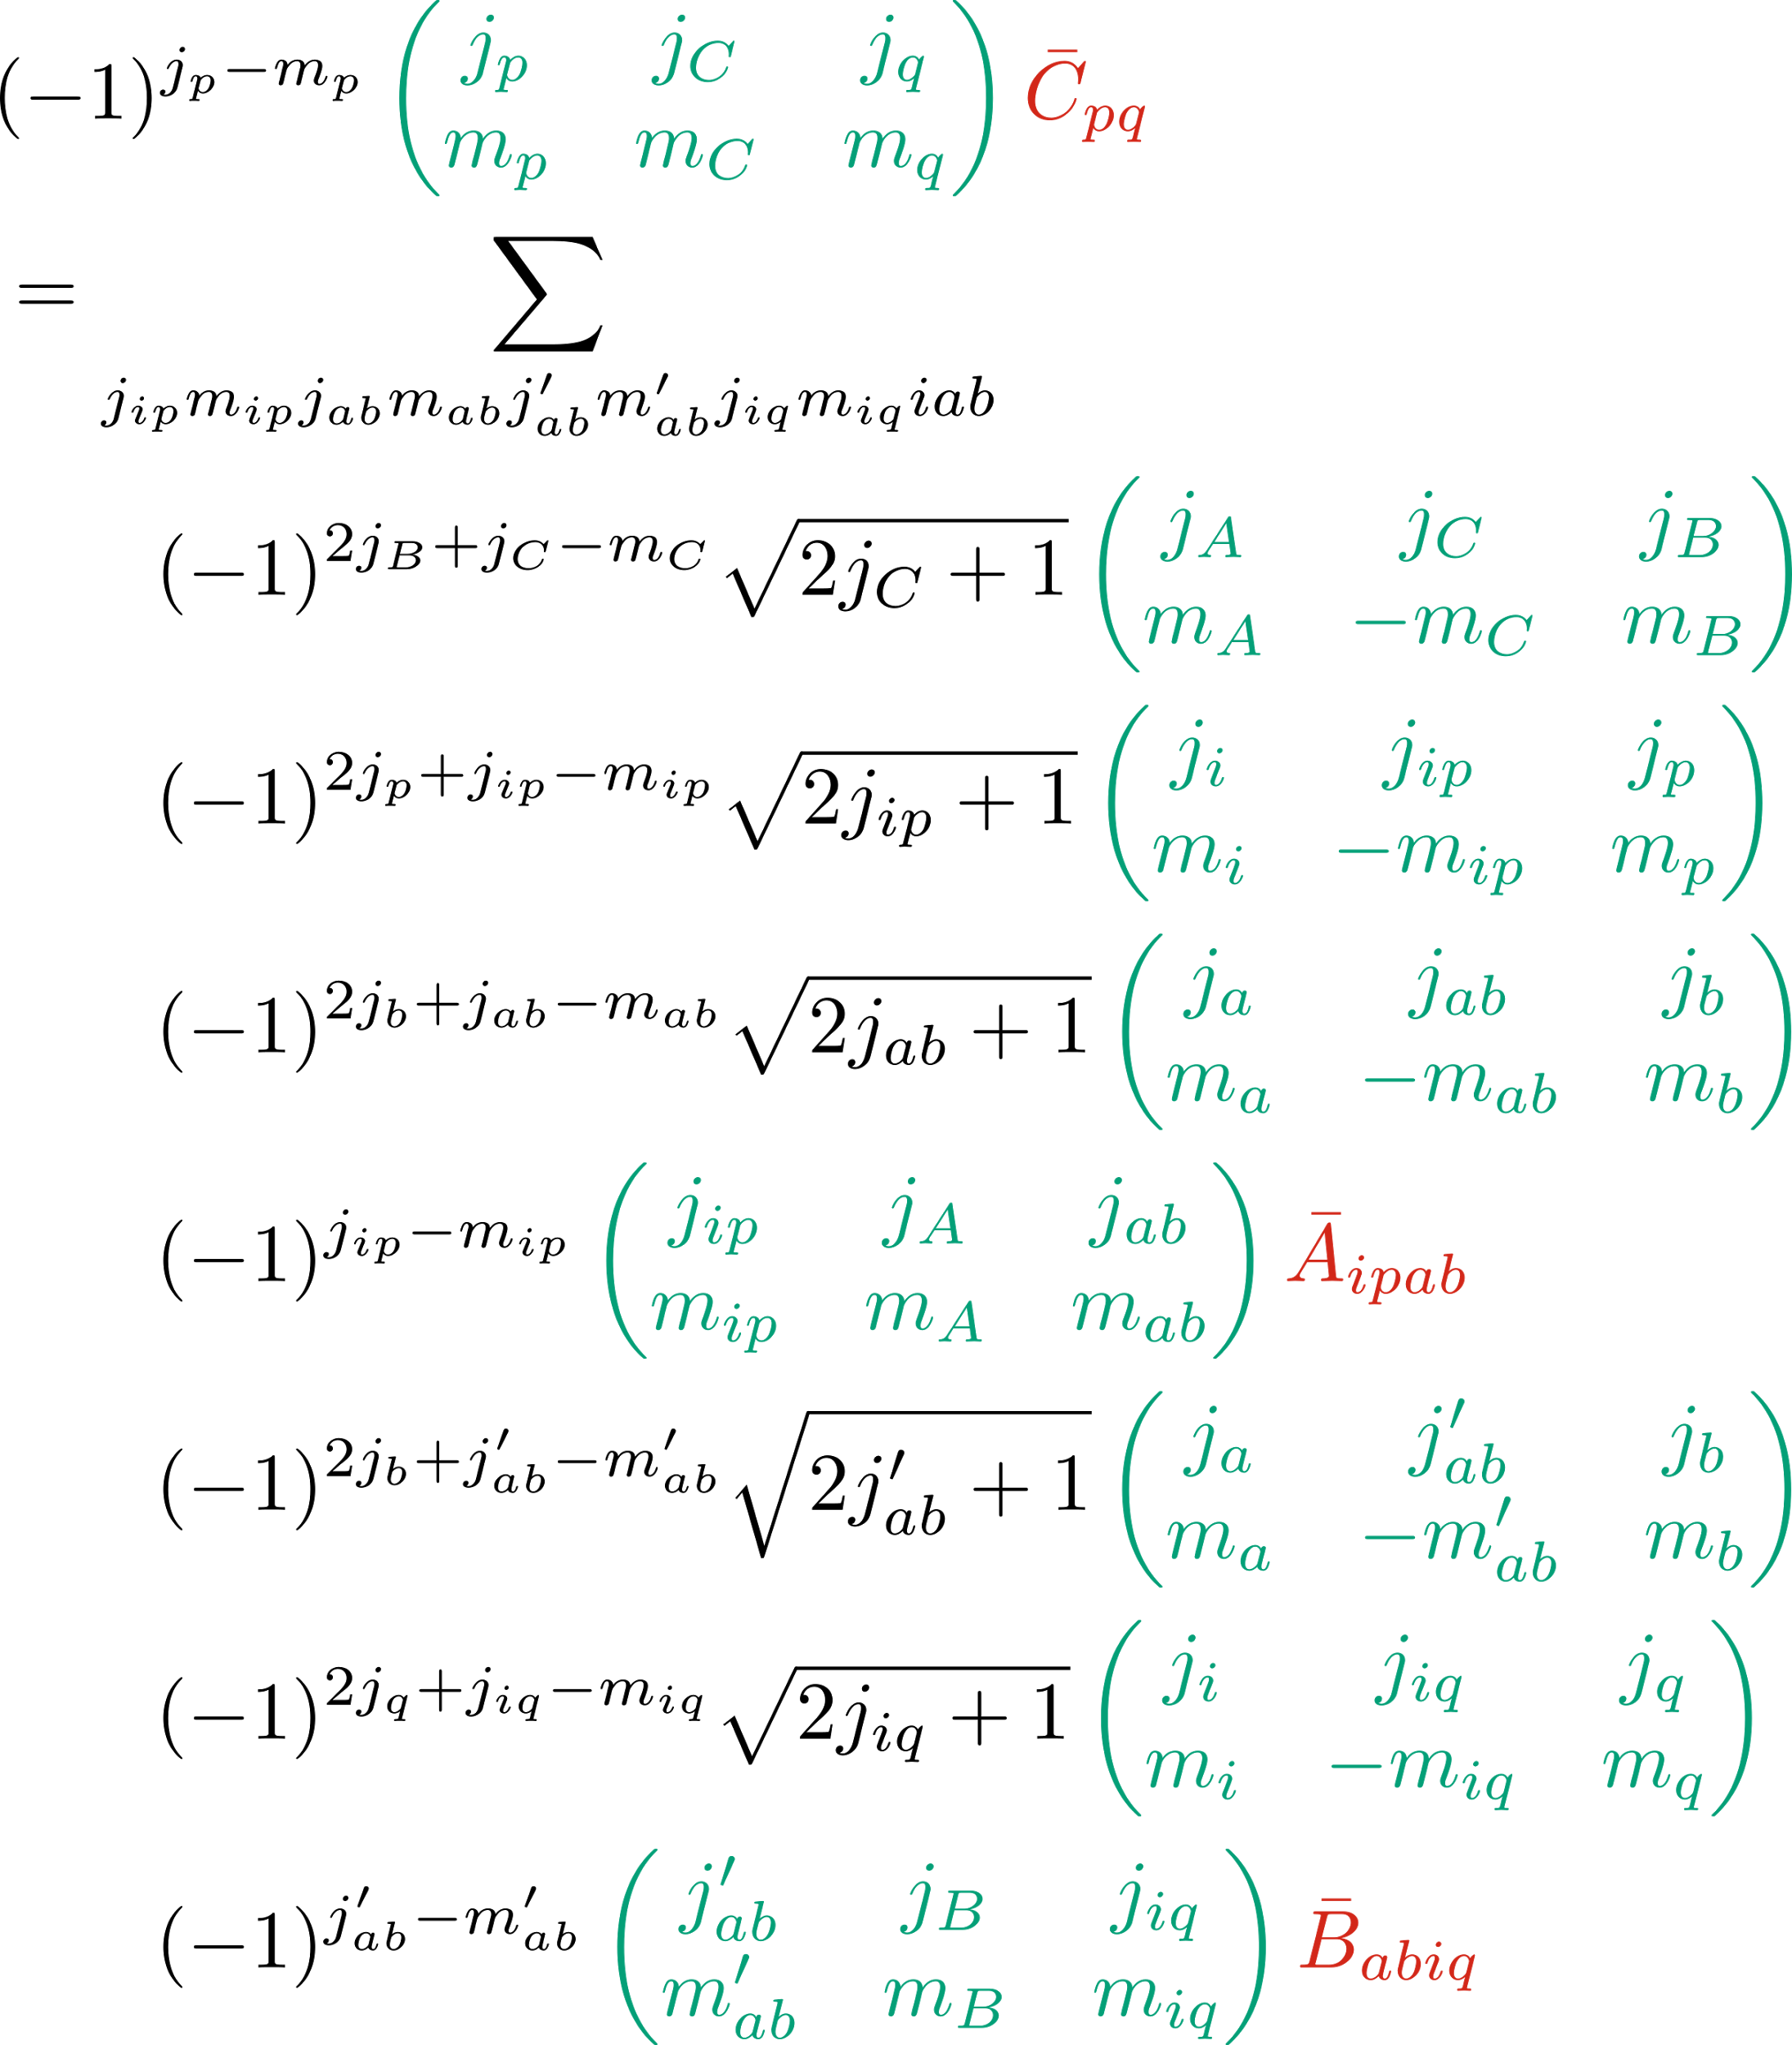
Example: equation before simplification
~ 32 variables
Algebraic approach: error-prone + non-intuitive
3-jm symbols: building blocks of angular momentum expressions
physical (reduced) matrix element
Notes:
(\check{\alpha}, \beta, \gamma) = (-1)^{j_\alpha - m_\alpha} \begin{pmatrix} j_\alpha & j_\beta & j_\gamma \\ -m_\alpha & m_\beta & m_\gamma \end{pmatrix}
\langle\alpha, \beta | \gamma\rangle = \langle j_\alpha m_\alpha j_\beta m_\beta | j_\gamma m_\gamma \rangle
\begin{align*}
(\check{p}, C, q) \bar{C}_{p q} &=
\sum_{j_{ip} m_{ip} j_{ab} m_{ab} j_{ab}' m_{ab}' j_{iq} m_{iq} i a b} \langle A, B | C \rangle \\
&\qquad \langle i, p | ip \rangle \langle a, b | ab \rangle (\check{ip}, A, ab) \bar{A}_{i p a b} \\
&\qquad \langle a, b | ab' \rangle \langle i, q | iq \rangle (\check{ab}', B, iq) \bar{B}_{a b i q}
\end{align*}

Slide 16
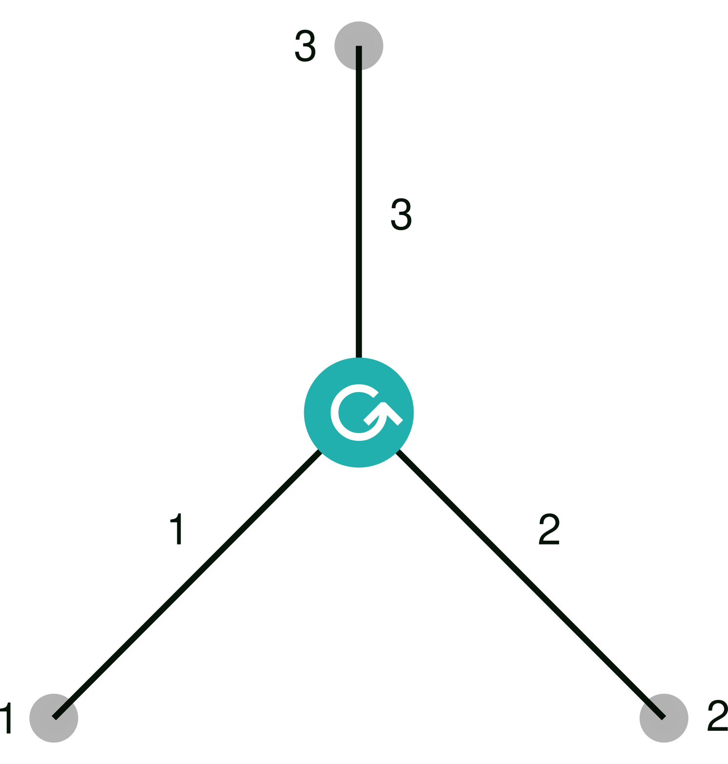
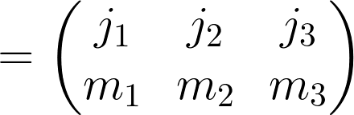
Intermission: Angular momentum diagrams
Inventor: [Jucys/Yutsis 1962]
Useful for manipulating angular momentum expressions
Each node is a 3-jm symbol
Each line is a (j, m) pair

Slide 17
Example: Diagrammatic derivation with jucys
Input:
wet (i + p) A (a + b)
wet (a + b) B (i + q)
wet p (A + B) q
https://rufflewind.com/img/jucys-diagram.mp4
Notes:
https://rufflewind.com/img/jucys-diagram.mp4

Slide 18
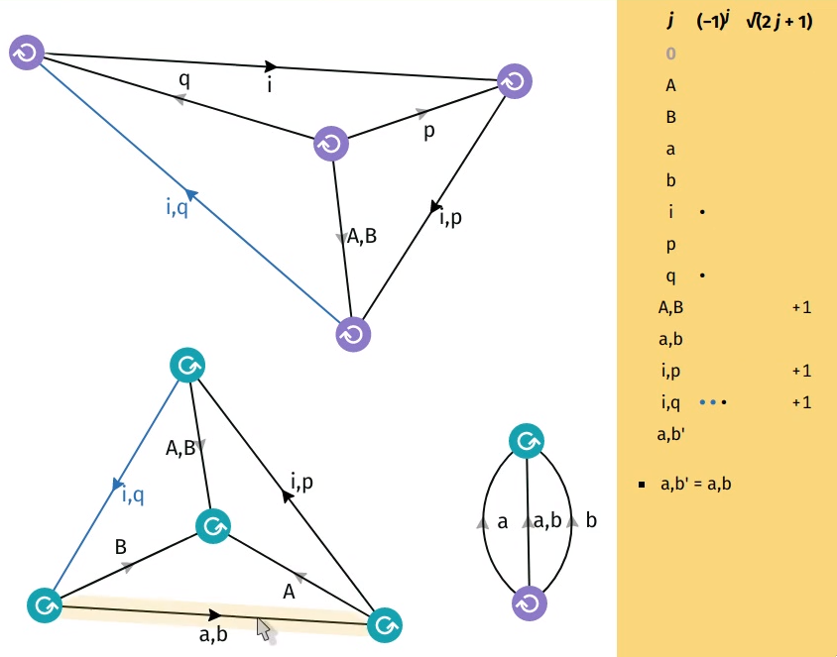
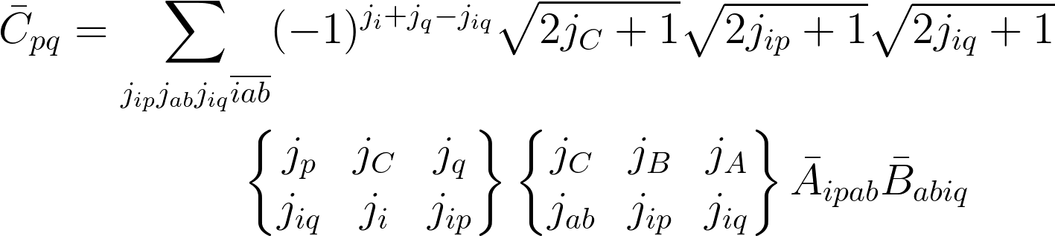
Example: Interpreting the diagrammatic result
Notes:
\begin{align*}
\bar{C}_{p q} &=
\sum_{j_{ip} j_{ab} j_{iq} \overline{i a b}} (-1)^{j_i + j_q - j_{iq}}
\sqrt{2 j_C + 1} \sqrt{2 j_{ip} + 1} \sqrt{2 j_{iq} + 1} \\
&\qquad\qquad
\begin{Bmatrix} j_p & j_C & j_q \\ j_{iq} & j_i & j_{ip} \end{Bmatrix}
\begin{Bmatrix} j_C & j_B & j_A \\ j_{ab} & j_{ip} & j_{iq} \end{Bmatrix}
\bar{A}_{i p a b} \bar{B}_{a b i q}
\end{align*}

Slide 19
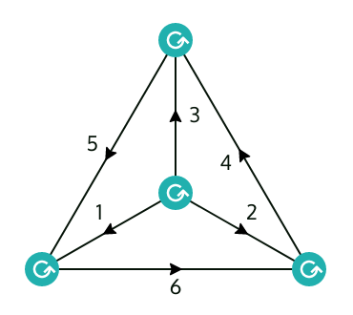
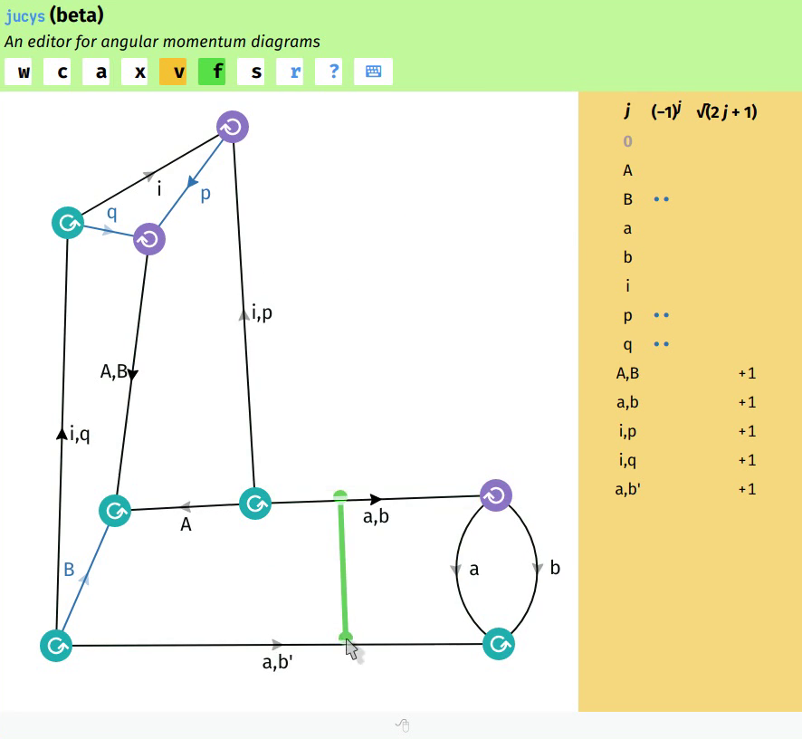
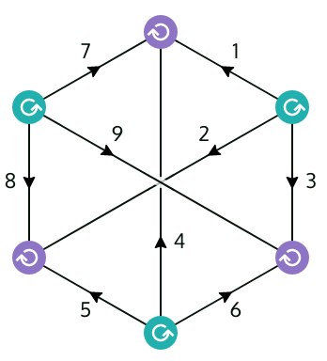
Graphical tool for angular momentum diagrams
My open-source graphical JavaScript app:
https://rufflewind.com/jucys
Try it online! (requires keyboard + mouse)
Display/draw/edit any angular momentum diagram
Input tool: create diagrams from a textual description
Reduction mode: ensure all change preserve equality; enforce rules of the “game” to prevent mistakes

Slide 20
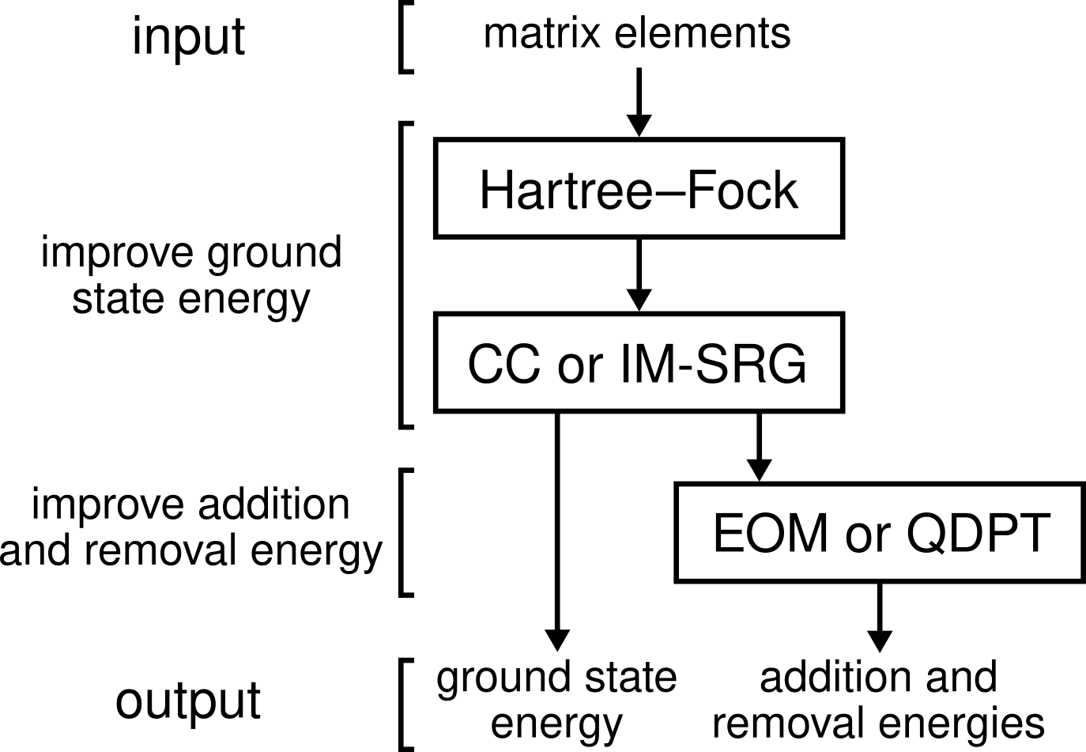
Theory pipeline
(HF)
Notes:
[[TODO: what is HF, EOM, CCSD?]]

Slide 21
Implementation of many-body methods
My open-source Rust library for many-body theory:
https://github.com/xrf/lutario
Implements: HF, MP2, IM-SRG(2), QDPT3
Systems: quantum dots, homogeneous electron gas, infinite nuclear matter, nuclei (soon: neutron drops)
Flexible: general many-body machinery that works for any quantum system, either J- or M-scheme
Extending code to support new systems involves just two aspects: input matrix elements + single-particle basis
MP2: 2nd order Møller–Plesset PT
Rust: a modern systems programming language focused on performance, safety, and concurrency

Slide 22
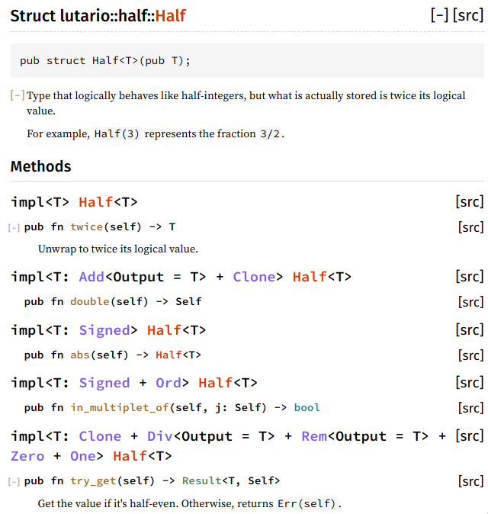
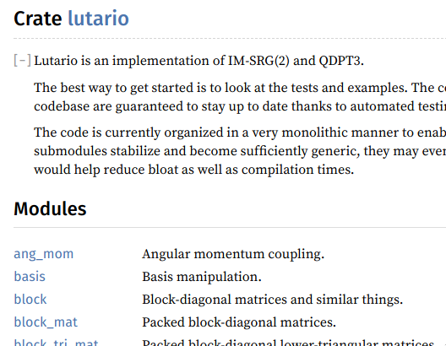
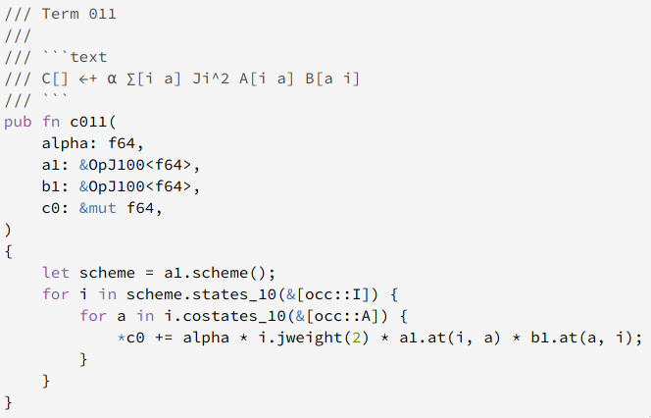
Code quality
Extensive testing and cross-checks for HF, IM-SRG(2) commutator, and QDPT3 in multiple quantum systems
Automated testing and failure notification (continuous integration)
API documentation available through Rustdoc
Adheres to official style convention of language

Slide 23
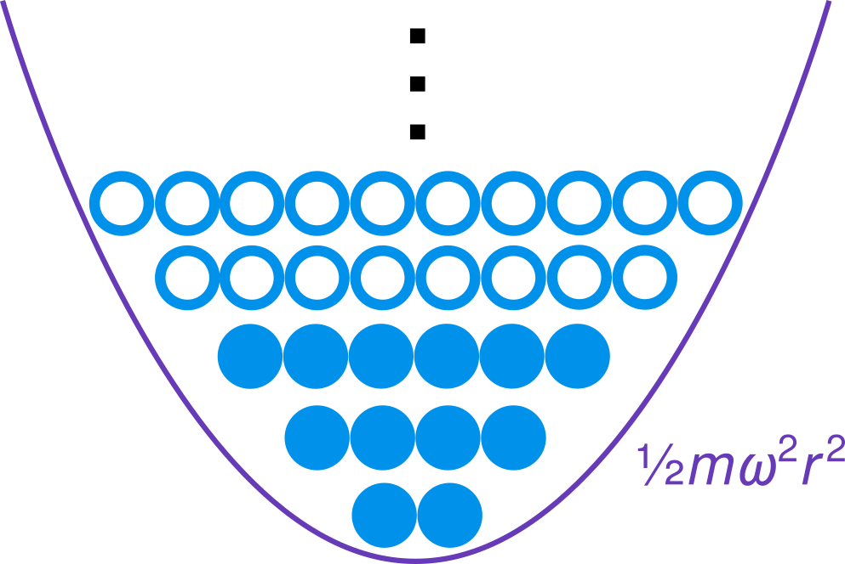
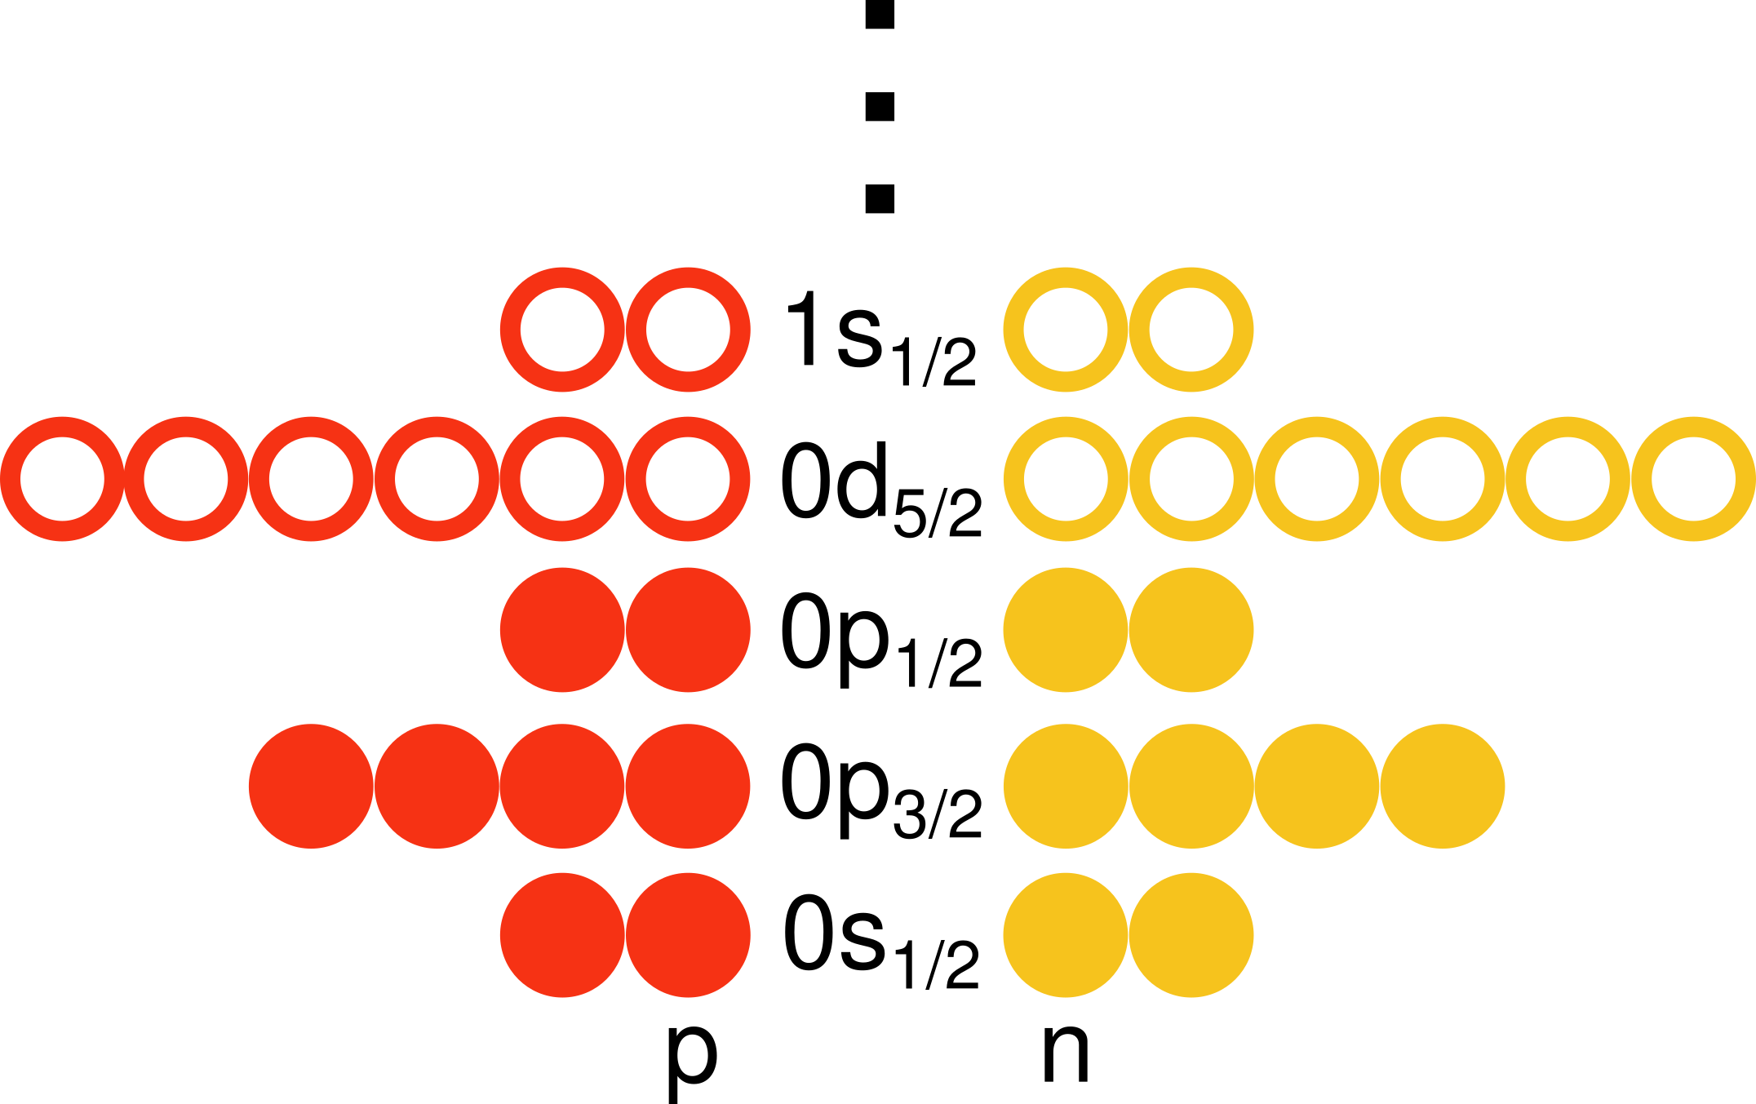
Systems: quantum dots and nuclei
Quantum dots
2D system of N electrons in a quadratic well
Potential: harmonic oscillator of frequency ω
Interaction: standard Coulomb repulsion
Basis: harmonic oscillator of same frequency ω (K = number of shells)
Units: atomic units
Nuclei
3D self-bound system of Z protons and N neutrons
Interaction: Entem–Machleidt (2003) chiral EFT N³LO (Λ = 500 MeV) SRG-softened to λ = 2 fm⁻¹
Basis: harmonic oscillator of frequency ω (e_{max} + 1 = number of shells)
Units: nuclear units (MeV and fm)

Slide 24
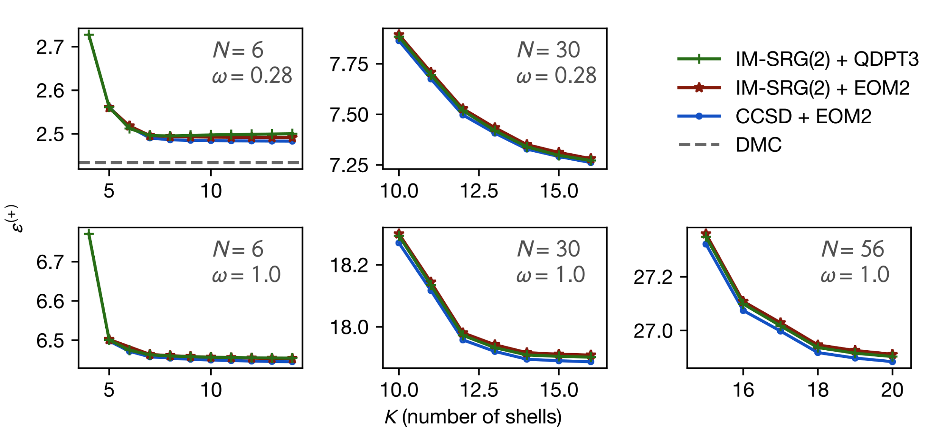
Addition energies of quantum dots
CCSD: CC with singles and doubles EOM2: EOM with up to two-particle excitations
Collaboration:
IM-SRG(2) + EOM2 results by Nathan M. Parzuchowski
CCSD + EOM2 results by Samuel J. Novario
Yuan et al. JCP (2017) doi:10.1063/1.4995615
DMC: Diffusion Monte Carlo
by [Pedersen et al (2011) PRB]

Slide 25
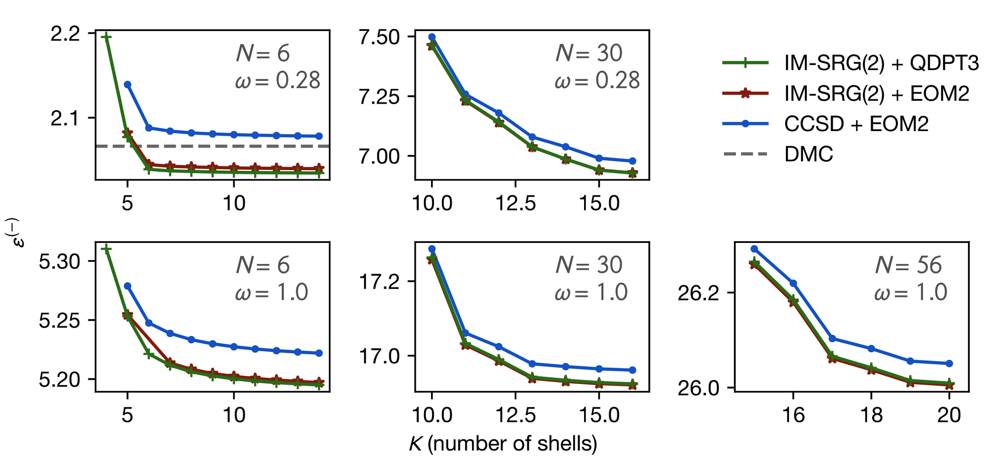
Removal energies of quantum dots
Collaboration:
IM-SRG(2) + EOM2 results by Nathan M. Parzuchowski
CCSD + EOM2 results by Samuel J. Novario
Yuan et al. JCP (2017) doi:10.1063/1.4995615
DMC: Diffusion Monte Carlo
by [Pedersen et al (2011) PRB]

Slide 26
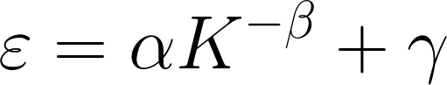
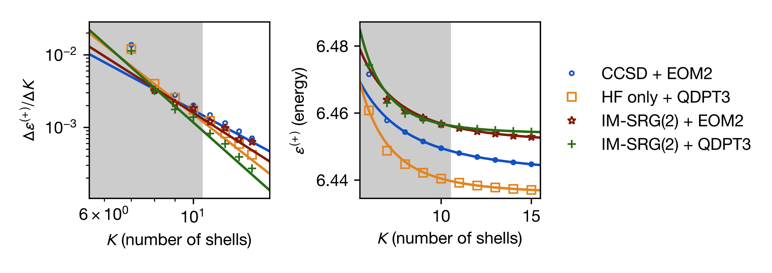
Extrapolation of quantum dot energies
Kvaal (2009) PRB
(shaded area excluded from fit)
Collaboration:
IM-SRG(2) + EOM2 results by Nathan M. Parzuchowski
CCSD + EOM2 results by Samuel J. Novario
Yuan et al. (2017) JCP doi:10.1063/1.4995615
Notes:
\varepsilon = \alpha K^{-\beta} + \gamma

Slide 27
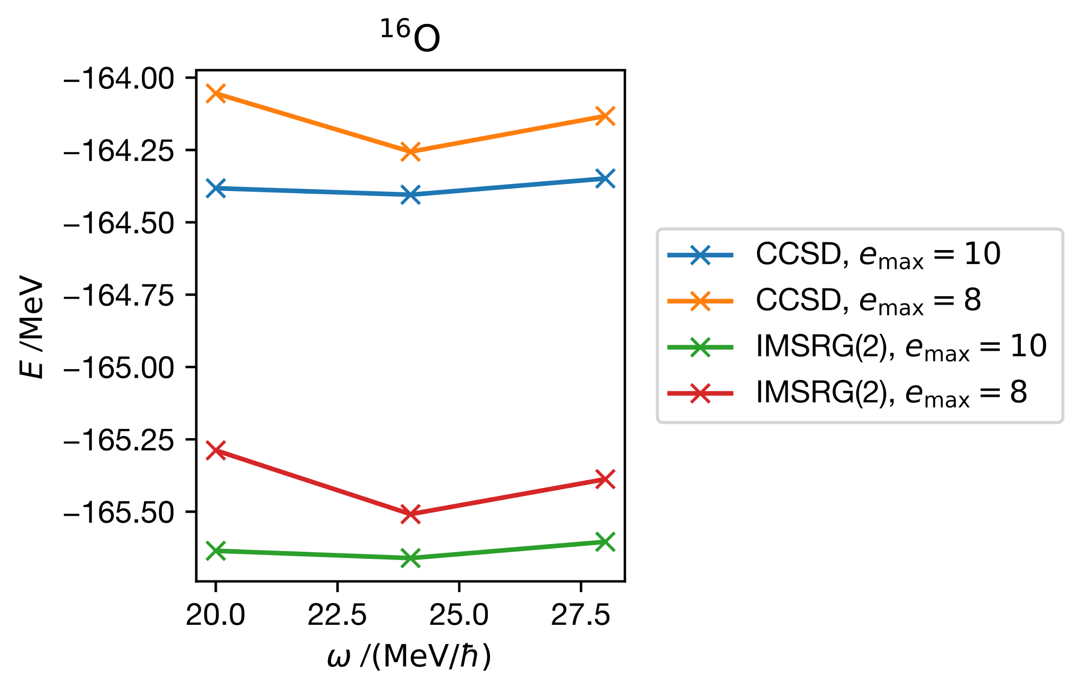
Ground state energy of ¹⁶O
Collaboration:
(Experiment: −127.6 MeV)
CCSD + EOM2 results by Samuel J. Novario
Notes:
[[you should talk about osc freq]]

Slide 28
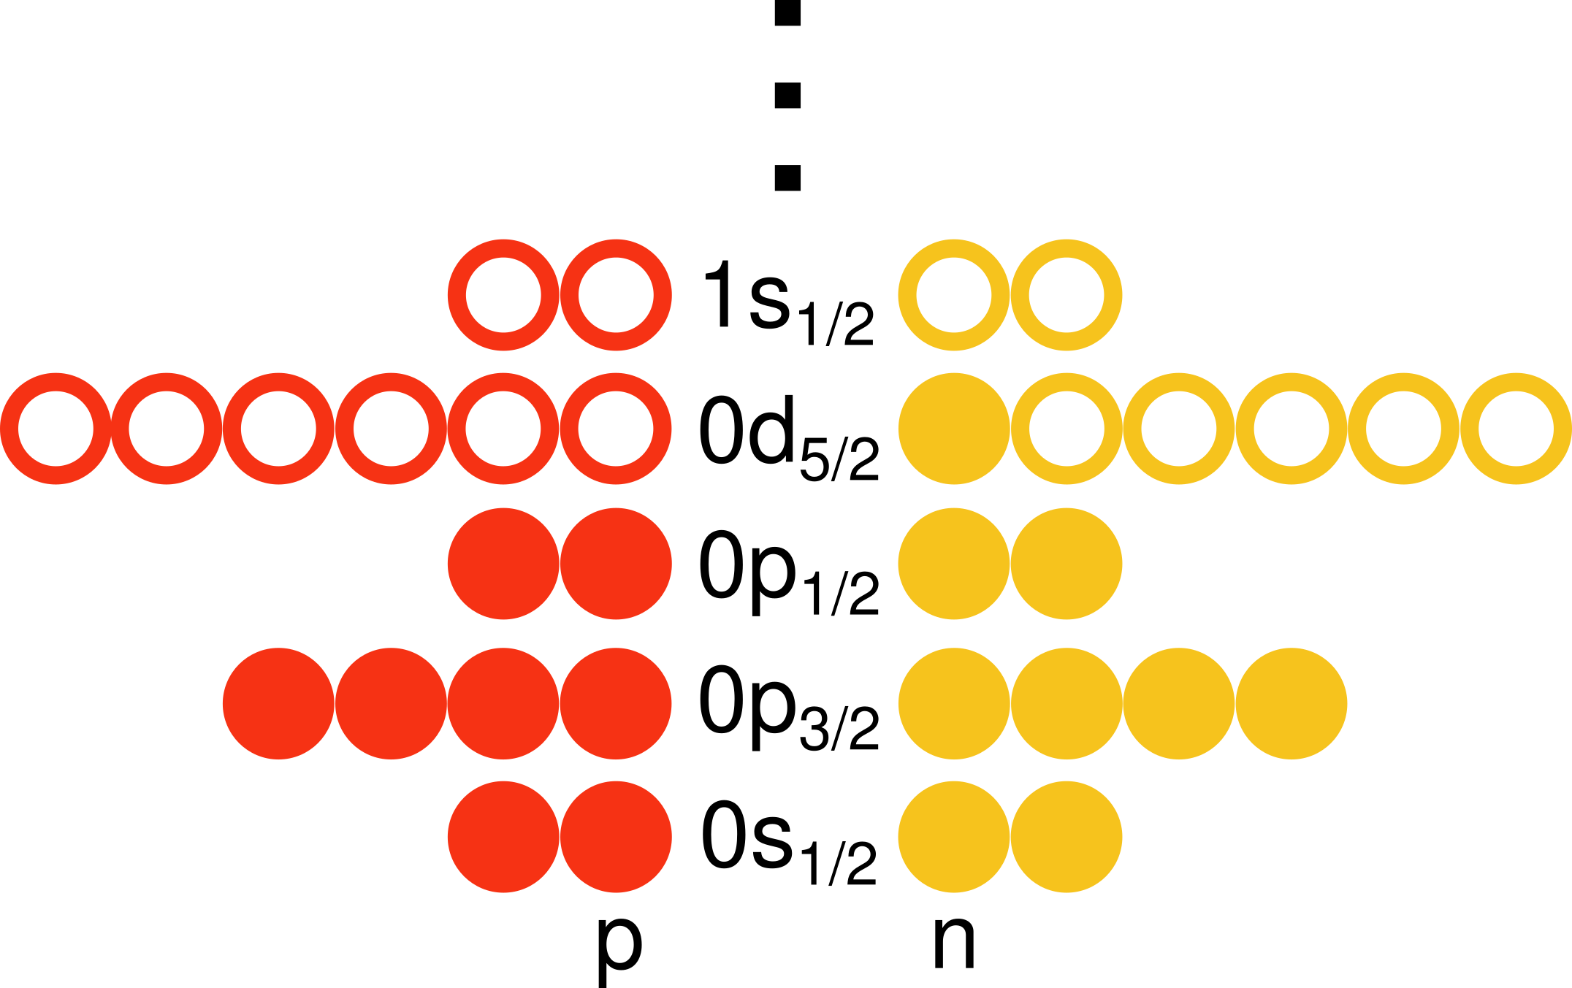
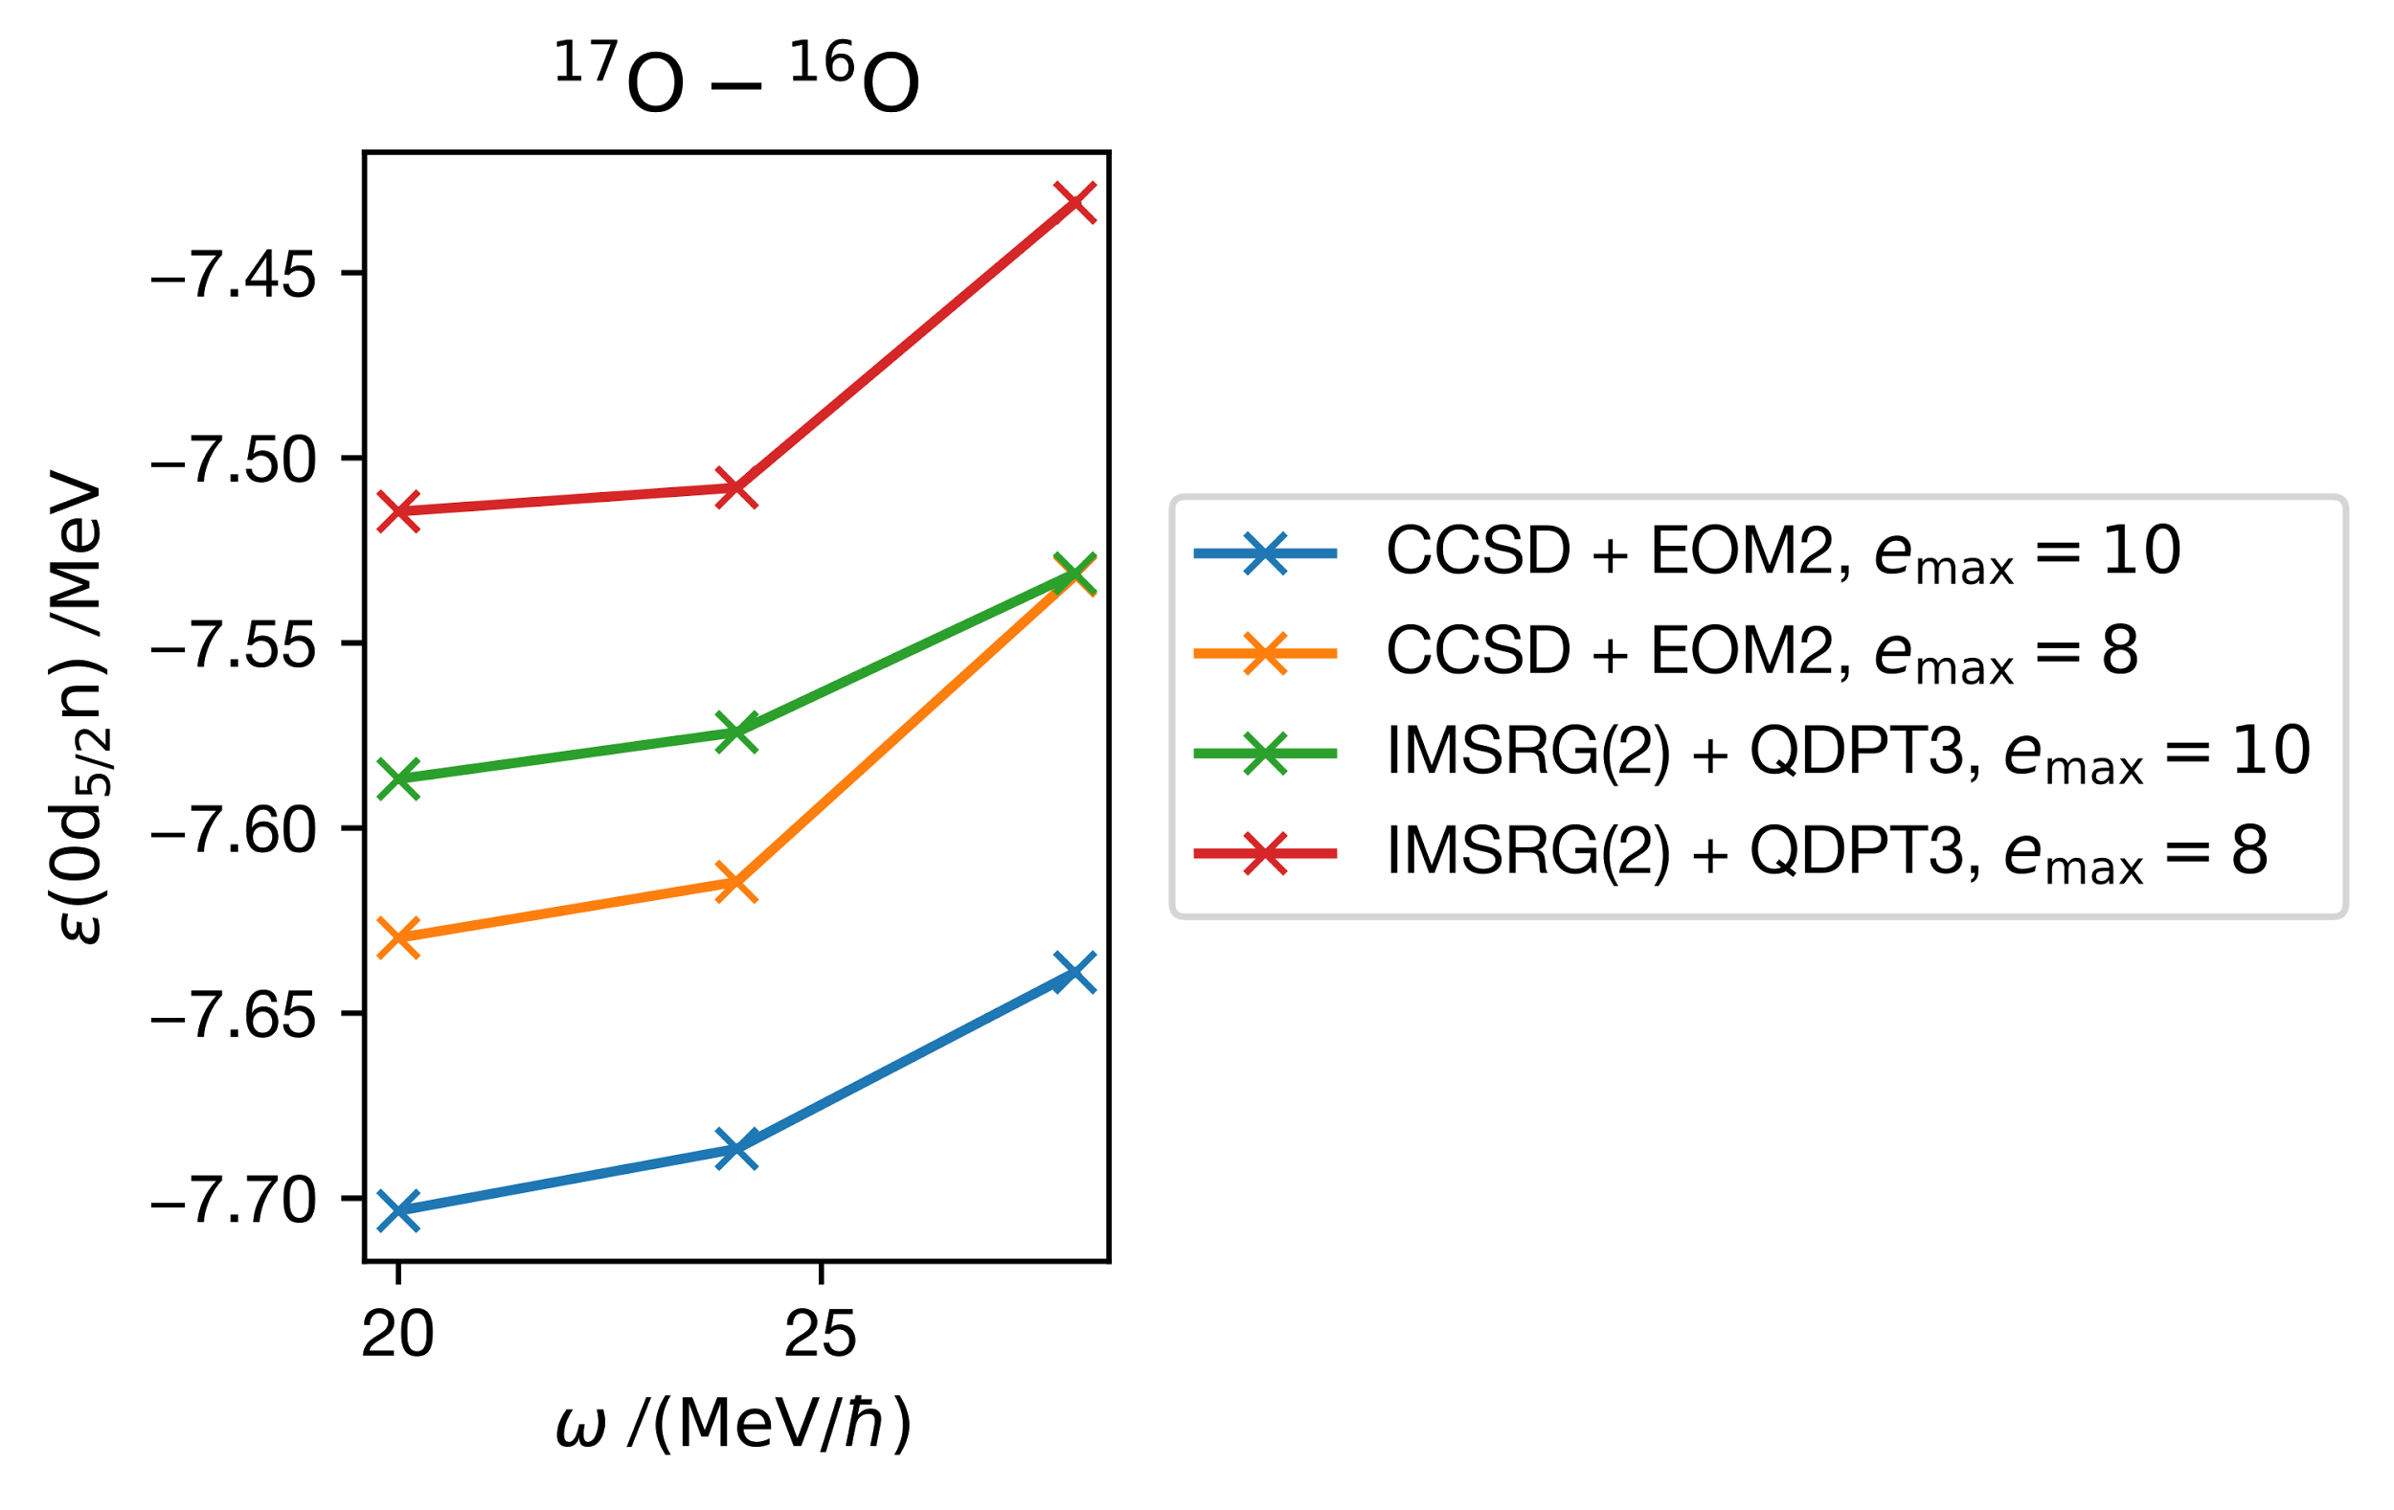
Addition energy of ¹⁷O from ¹⁶O
note the scale!
Collaboration:
(Experiment: −4.1 MeV)
CCSD + EOM2 results by Samuel J. Novario

Slide 29
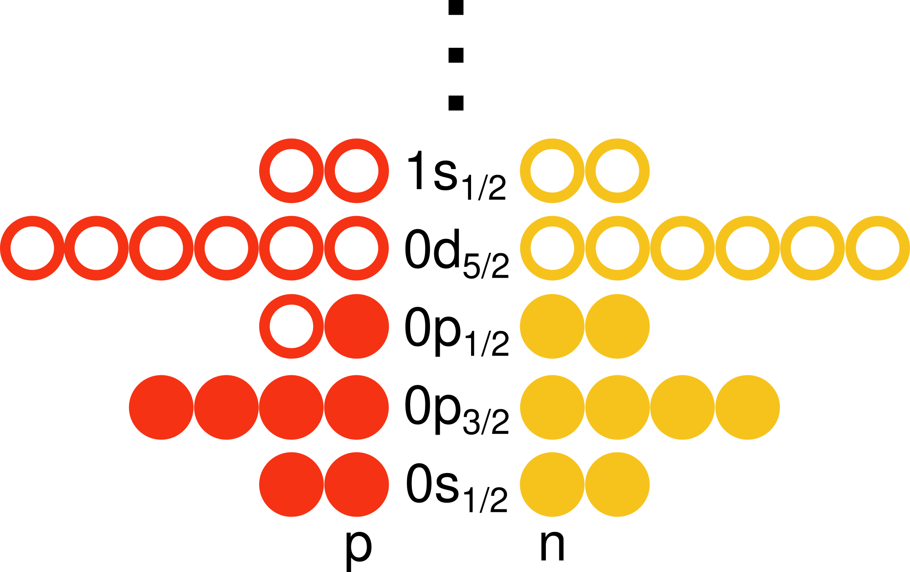
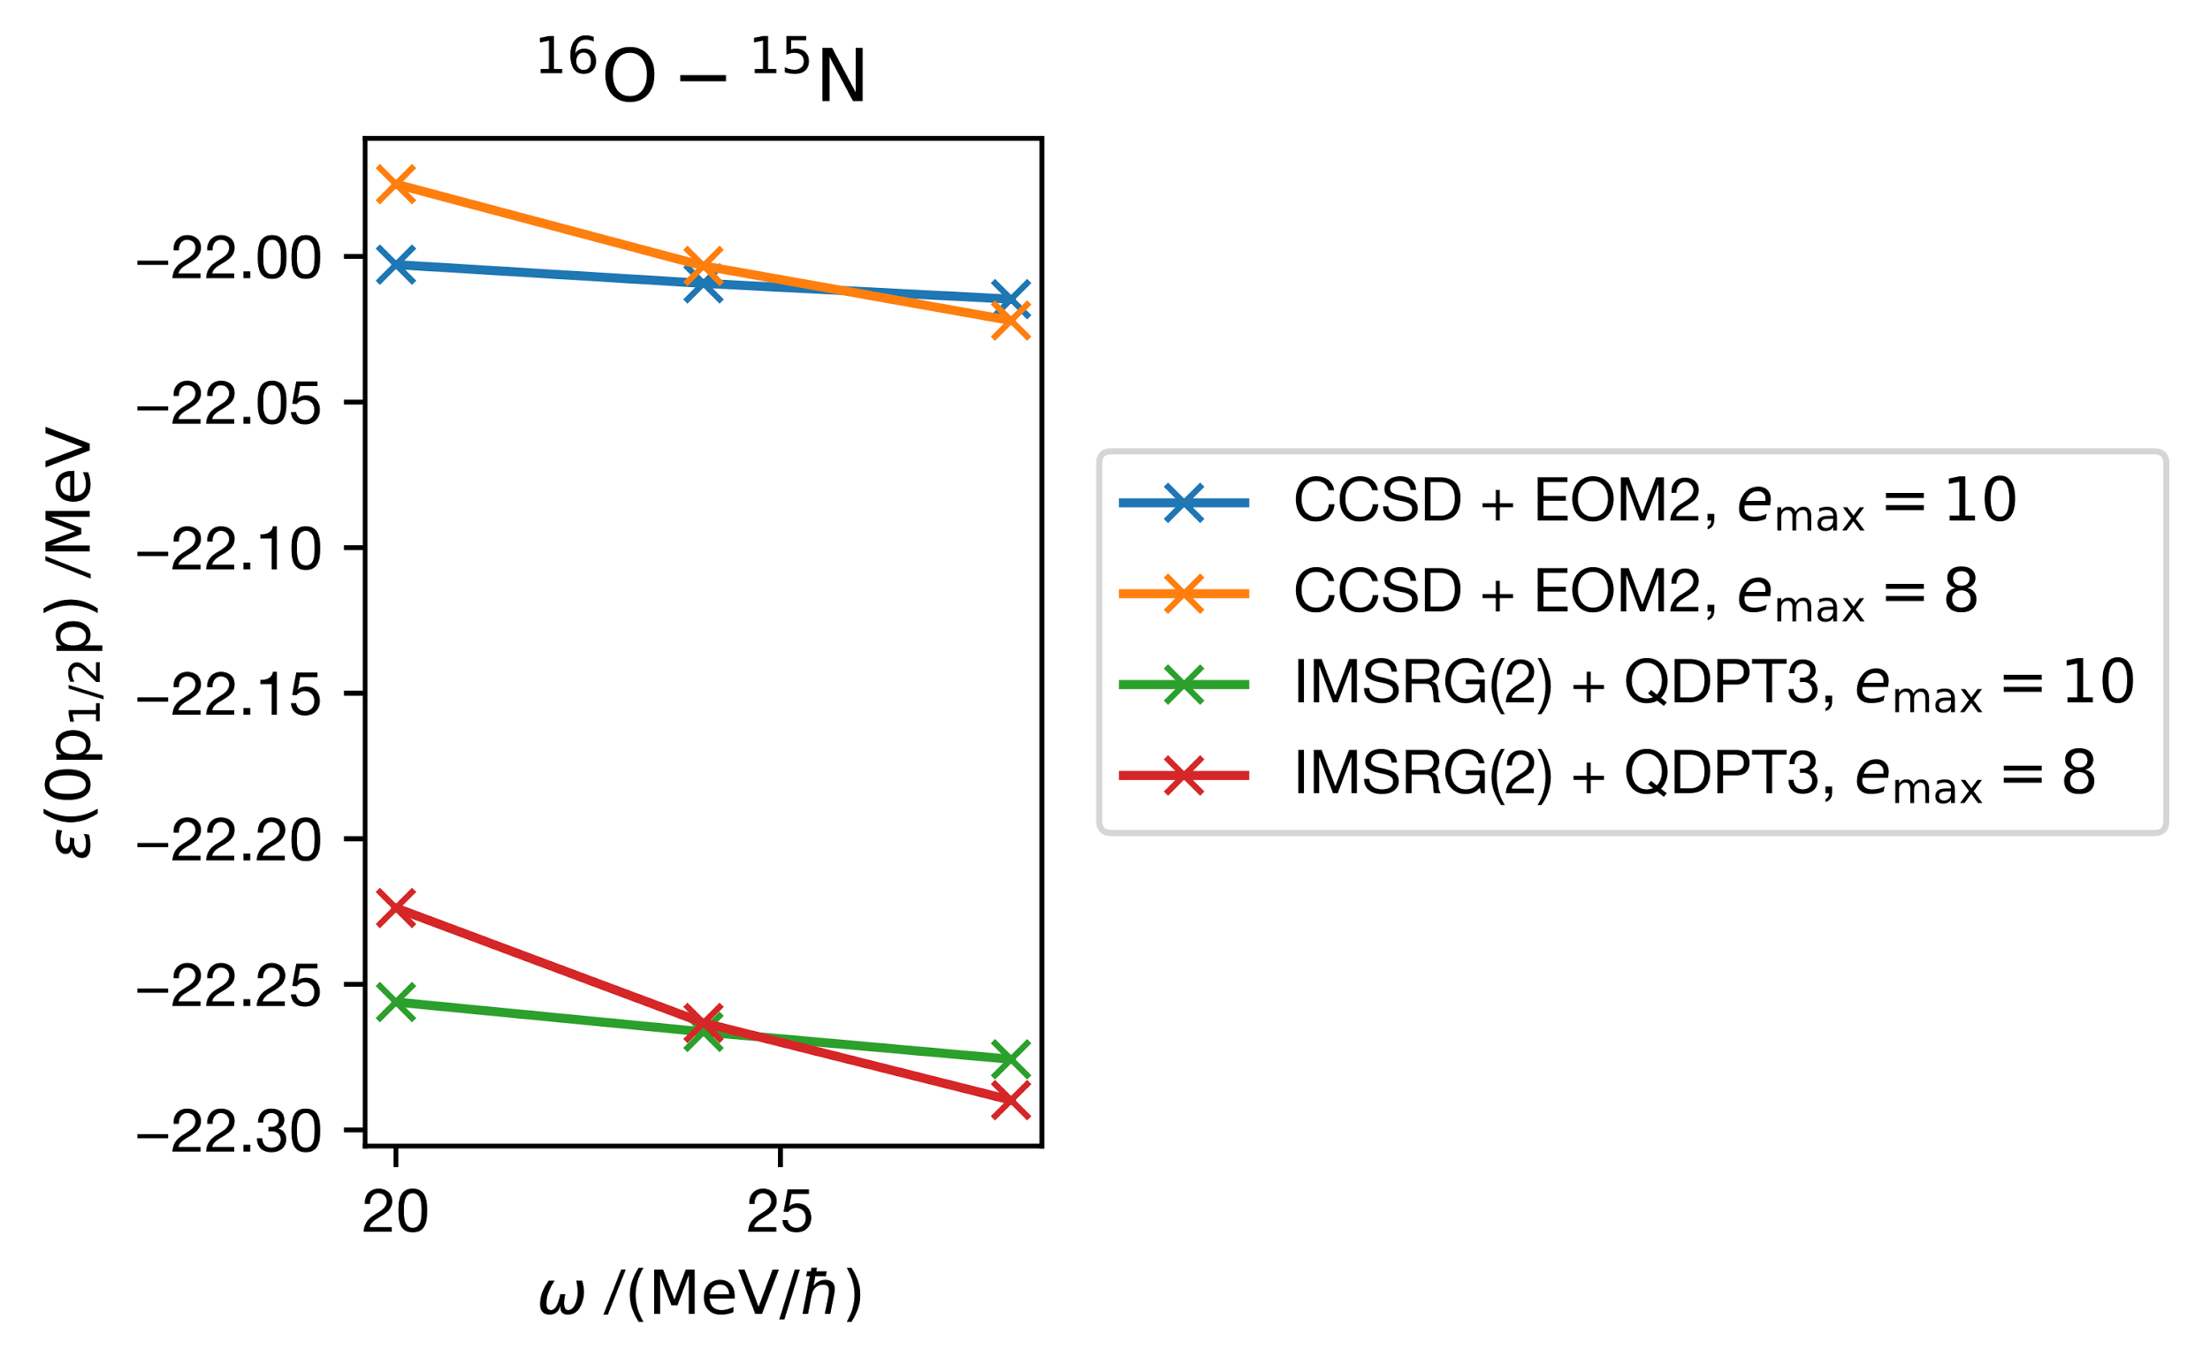
Removal energy of ¹⁵N(1/2⁻) from ¹⁶O
Collaboration:
(Experiment: −12.1 MeV)
CCSD + EOM2 results by Samuel J. Novario

Slide 30
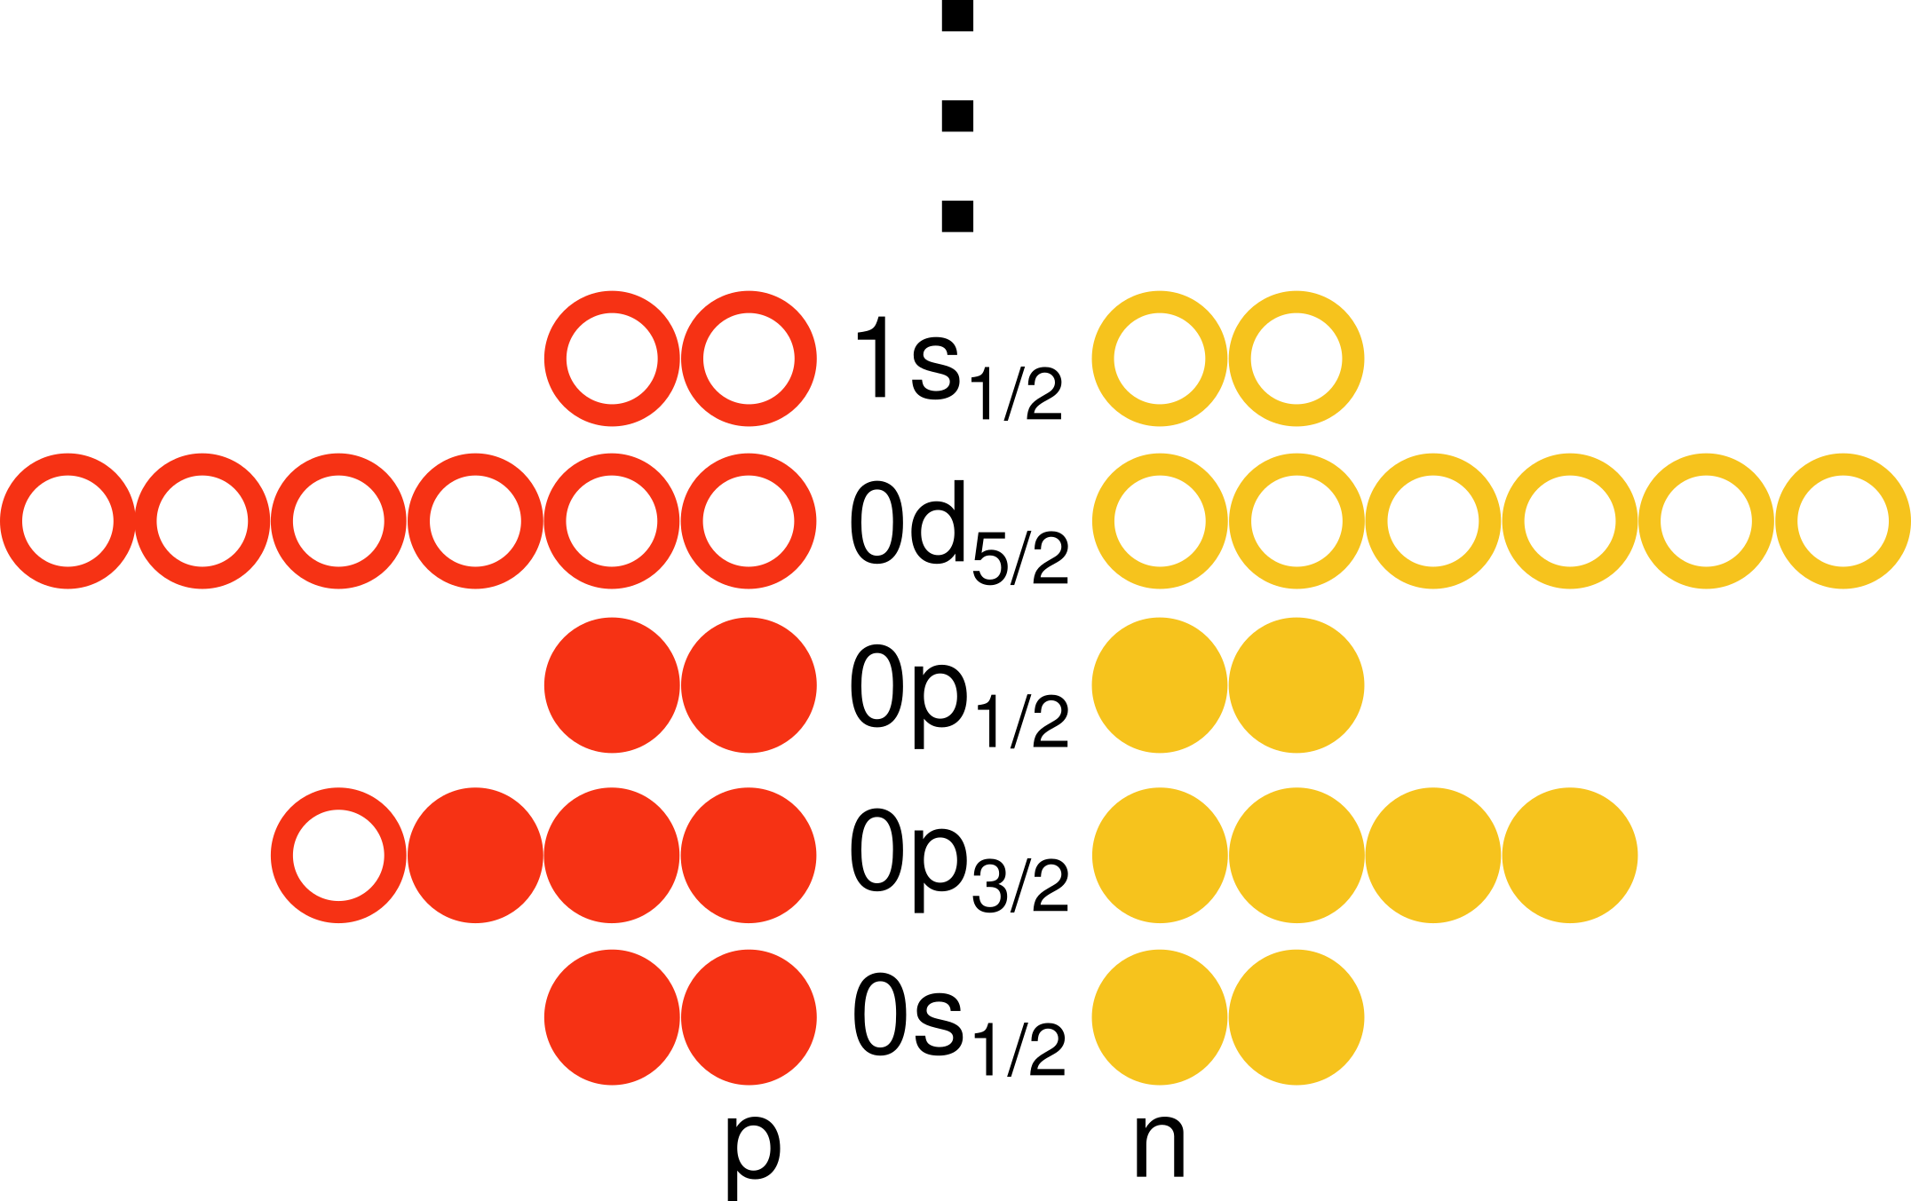
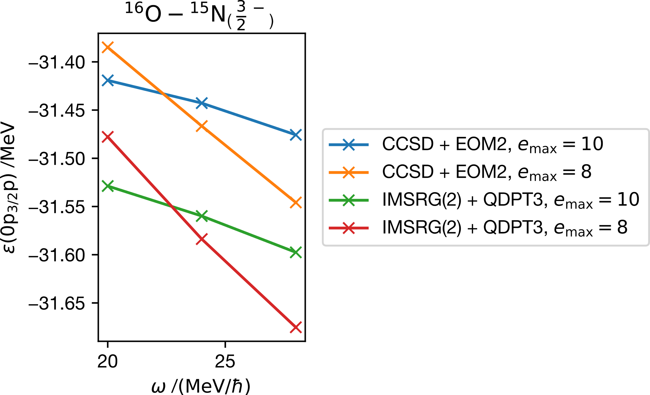
Removal energy of excited ¹⁵N(3/2⁻) from ¹⁶O
Collaboration:
(Experiment: −18.5 MeV)
CCSD + EOM2 results by Samuel J. Novario

Slide 31
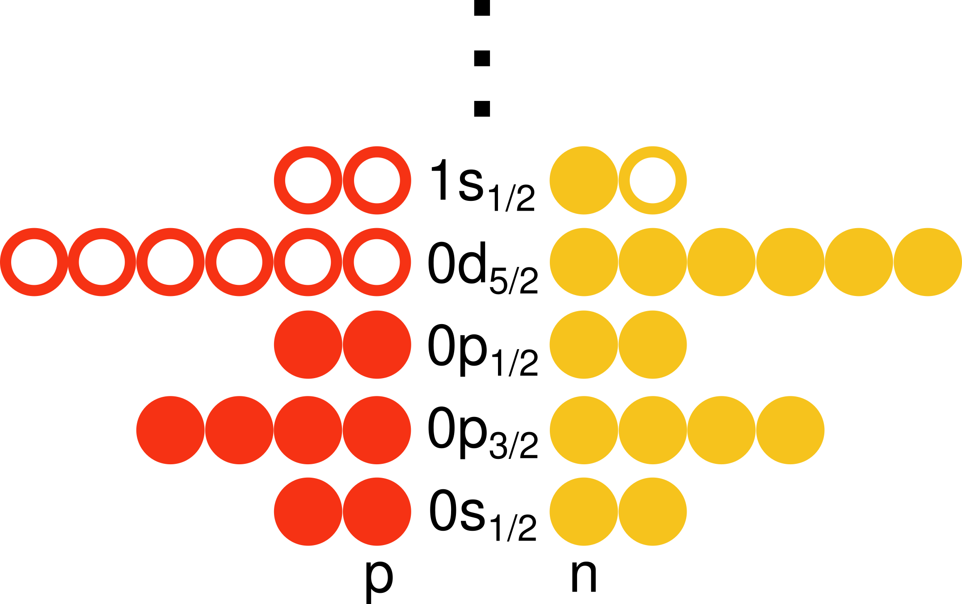
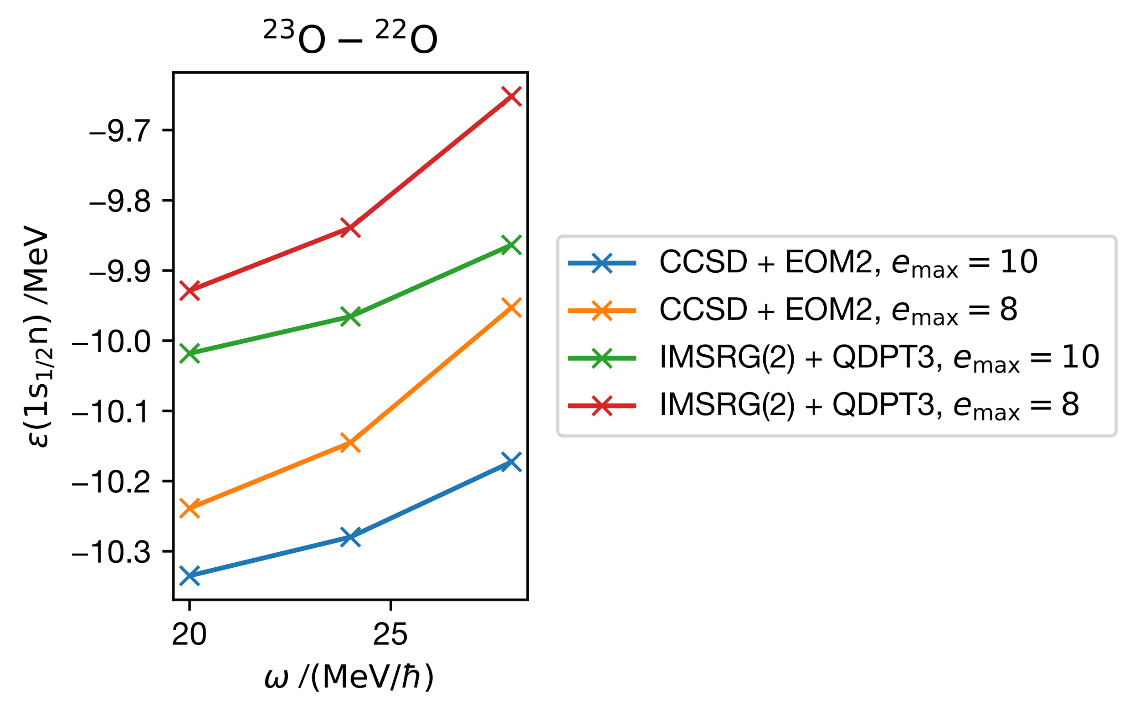
Addition energy of ²³O from ²²O
Collaboration:
(Experiment: −2.7 MeV)
CCSD + EOM2 results by Samuel J. Novario
Notes:
(this is the only one that is 3.7× off; all the other ones are 1.7-1.9× off)

Slide 32
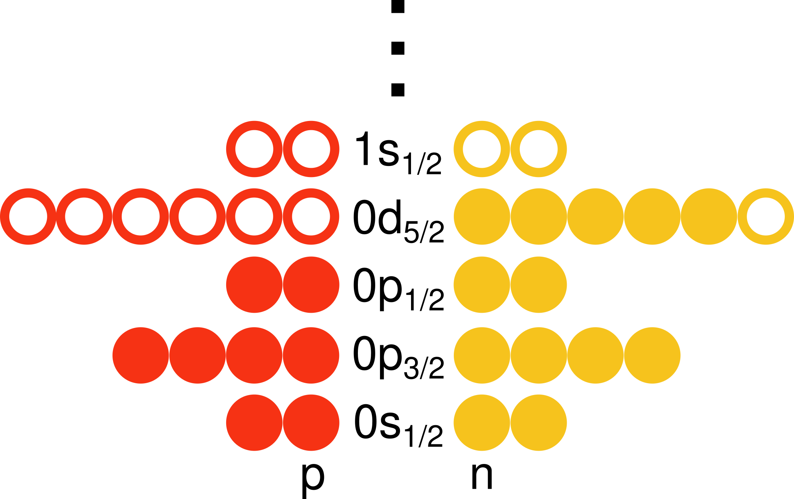
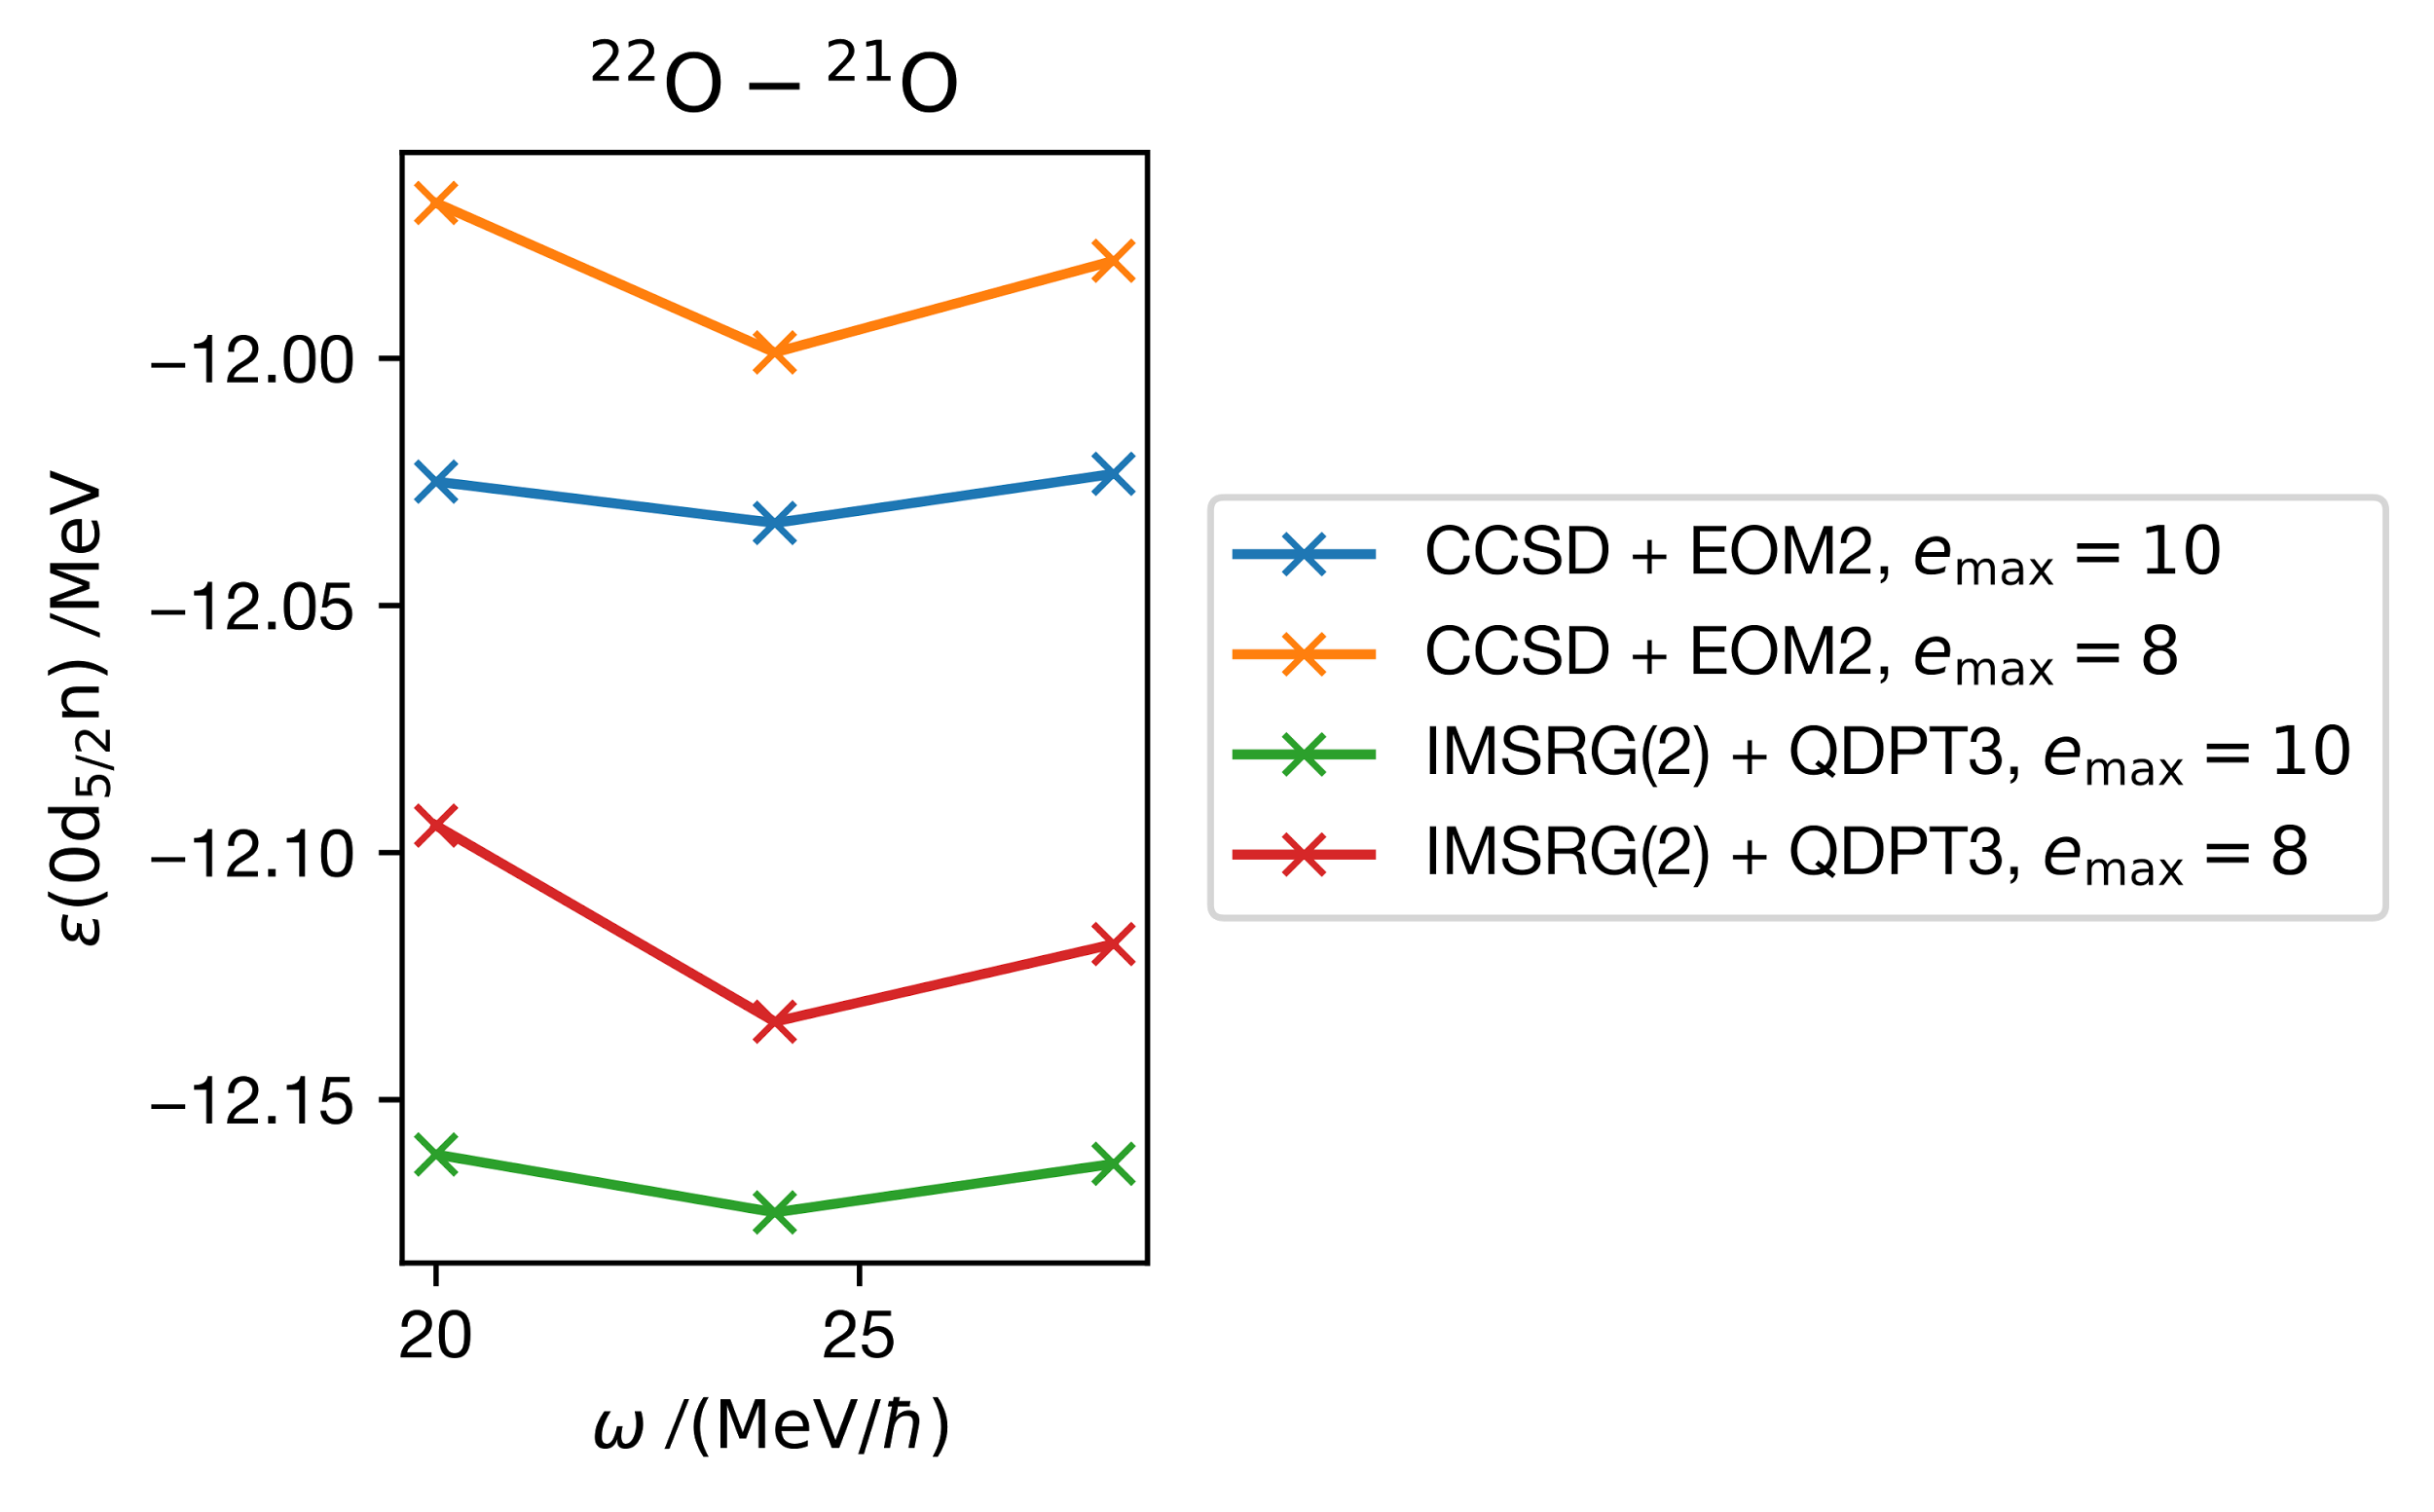
Removal energy of ²¹O from ²²O
Collaboration:
(Experiment: −6.9 MeV)
CCSD + EOM2 results by Samuel J. Novario

Slide 33
Recap
jucys: Graphical tool for angular momentum diagrams
lutario: Flexible, open-source code for J- and M-scheme many-body theories
Calculated addition and removal energies of quantum dots and nuclei using IM-SRG + QDPT
Results in good agreement with collaborators’
Nuclei: qualitative agreement with experimental values
Notes:
usually 80% larger than nucl expt

Slide 34
Future directions
Explore more parameters: basis size, isotope, interaction
Analyze convergence with respect to
size of single-particle basis
frequency of the harmonic oscillator basis
Extrapolate to infinite basis limit
Approximate inclusion of 3-body forces
Higher order IM-SRG and QDPT (e.g. IM-SRG(2*), QDPT4)
Code optimizations → larger system, higher precision
Study other systems: infinite matter, neutron drops
Explore other observables

Slide 35
Thank you!
Many-body theory group
Morten Hjorth-Jensen (advisor)
Scott Bogner (co-advisor)
Heiko Hergert
Nathan M. Parzuchowski (EOM-IMSRG results)
Samuel J. Novario (EOM-CC results)
Titus D. Morris
Justin Lietz
Committee
Morten Hjorth-Jensen (chair)
Scott Bogner
Alexandra Gade
Carlo Piermarocchi
Scott Pratt

